Slide 1
Streamlining Urology Pathways
Ms Catherine Dowling
Consultant Urologist
University Hospital Galway
7th Oct 2017

Slide 2
Outline
Haematuria
Initiatives /access improvements
Assessment of male LUTs
AUR pathway
LUTs in female patients, UTIs
PSA

Slide 3
Haematuria
Common complaint with multitude of causative factors (Infective, BPH, iatrogenic, renal, trauma, stones, malignancy)
Microscopic or visible
Painful or painless
Prevalence of microscopic haematuria is 0.19–21.0% ¹
Prevalence of urinary tract carcinomas among patients with macroscopic haematuria has been reported to be as high as 19%, but usually ranges from 3–6%.²
Up to 50% of patients with visible haematuria and 70% with microscopic haematuria have no identifiable cause found³
¹Grossfield GD et al. Asymptomatic microscopic haematuria in adults: summary of the AUA Best Practice Policy Recommendations. Am Fam Physician 2001;63:1145–53
²O’Connor OJ et al. Imaging of haematuria. AJR Am J Roentgenol 2010;195:263–7
³ Khadra MH, Pickard RS, Charlton M, Powel PH, Neal DE. A prospective analysis of 1930 patients with hematuria to evaluate current diagnostic practice. J Urol 2000;163:524–7.

Slide 4
Anticoagulation
The prevalence of haematuria is no higher in patients who are anticoagulated within the therapeutic range, therefore the same investigations as those performed in patients who are not anticoagulated apply.⁴
⁴ Culclasure TF, Bray VJ, Hasbargen JA. The significance of hematuria in the anticoagulated patient. Arch Intern Med 1994;154:649–52.
A urological referral is recommended in patients presenting with visible haematuria, persistent microscopic haematuria, irritative lower urinary tract symptoms or recurrent urinary tract infections.

Slide 5
Risk factors for malignancy
Age >40 years
Smoking history
Visible haematuria
Chronic inflammation (SCC)-chronic cystitis, long-term catheter, bladder stones, Schistosomasis (dysuria+)
Prior pelvic irradiation
Occupational exposure to known carcinogens – printing, iron, aluminium processing, gas and tar manufacturing (aromatic amines, aniline dyes
Drugs-cyclophosphamide, phenacetin

Slide 6
Investigation
Urine culture to outrule UTI
Imaging – to ensure upper tracts normal
Flexible cystoscopy to outrule bladder tumour

Slide 7
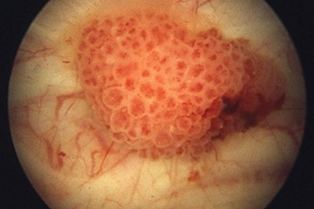
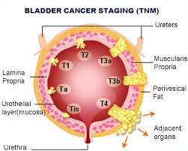
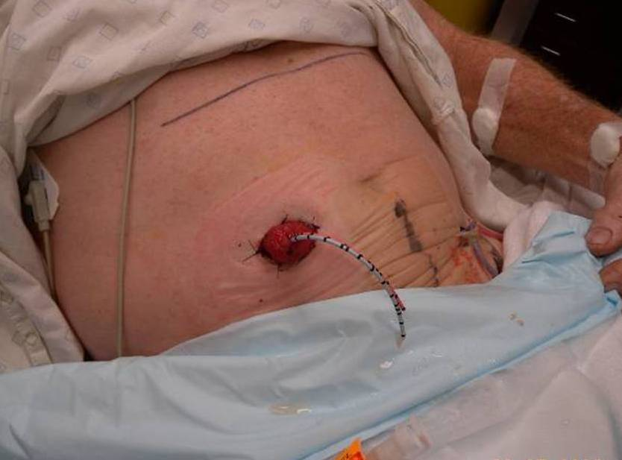

Slide 8
Challenges
Access to imaging
Access to flexible cystoscopy
Attempt to reduce clinic visits per patient
Attempts to reduce numbers of patient admissions

Slide 9
Initiatives/Access improvements
Improved triage of referrals – pts with visible haematuria and risk factors → Urgent direct flexible cystoscopy
Further 3 flexible cystoscopy per week lists commenced Feb 2016. These initially targeted those on WL but now direct access for haematuria clinic.
Pt will be triaged to haematuria clinic based on your referral, 1-2 visits with cystoscopy + imaging (some ongoing challenges with ring-fencing scan slots).
Helpful to know creat and if risk factors.

Slide 10
Emergency dept referrals
Important role
Heavy haematuria with clots
Clot retention
Low haemoglobin sec to haematuria
Clinically unwell patient

Slide 11
Benign Prostatic Hyperplasia / Male LUTs

Slide 12
Background
Symptomatic BPH is set to grow by approx. 50% by the year 2025
Consultations and prescriptions for medical therapy for symptomatic BPH has increased
Uncomplicated LUTS related to BPH can initially be managed in primary care
Eur Urol 1999; 36 Suppl 3:33-9.

Slide 13
Guidelines for the Primary Care Management of Male Lower Urinary Tract Symptoms
Lower Urinary Tract Symptoms (LUTS)
Aimed specifically at general practitioners and patients (patient information leaflets).
Intended to help with diagnosis, treatment and monitoring
Notes:
Baus have issued guidelines

Slide 18
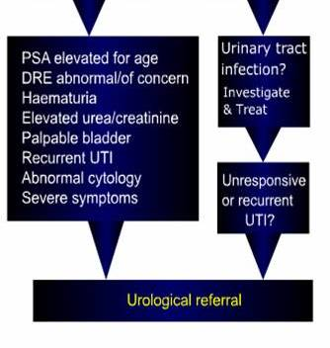

Slide 19
α-blockers
α 1a receptors predominant in prostate smooth muscle
Mediates contraction of smooth muscle
Many α-blockers selective for prostate
S/e’s include postural hypotension and retrograde ejaculation (10%)

Slide 20
5α-reductase inhibitors
Inhibits conversion of testosterone to DHT
DHT promotes expression of growth factors which stimulate prostate growth
Dutasteride inhibits both type 1 and type 2 isoenzymes
Decreases prostate size and vasculature
6/12 to benefit
Approx. halves PSA

Slide 21
BPH Progression
Symptomatic progression
Increasing bothersomeness
Urinary retention
Renal insufficiency

Slide 22
Urological investigations
IPSS
U&E, PSA, MSU
+-Renal ultrasound
Uroflow and post void residual

Slide 23
Uroflow
Uroflow - patient drinks until bladder comfortably full
Voids into receptor
This measures volume voided and time to void
Maximum and average flow rate calculated
→ often enough in straightforward history
Post void residual bladder scan performed

Slide 24
Normal (unobstructed) flow
40
Flow rate mls/sec
Time
Q max (maximum flow rate)=36mls/sec (excellent flow rate)
Voided over short time as no obstruction

Slide 25
Obstructed flow
Flow mls/sec
10
Q max 13mls/sec, but average flow rate ~7mls/sec
This is the picture produced by an enlarged benign prostate ( ie a relatively elastic narrowing over a longer length).

Slide 27
Urethral stricture
Flow mls/sec
20
10
A urethral stricture is usually a pinpoint narrowing, often quite short. It is relatively rigid as it is really scar tissue (fibrous & dense), so very difficult to generate a maximum flow.
Q max here ~10mls/sec, avg flow ~5mls/sec
Pressure in bladder would be very high (>20mls H2O)

Slide 28
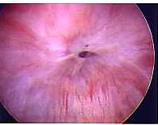
Dense urethral stricture
Pinpoint opening
Usually over short length
Diameter only large enough to admit guidewire
Fibrous scar tissue so not elastic

Slide 29
AUR

Slide 30
Acute urinary retention
Current initiative to streamline pathway for Trial of voiding for pts who present with AUR.
Working with ED in UHG to define a pathway involving CIT.
One page referral form flagged from ED to book TOV with urology (or CIT).
Pt provided with ‘catheter pack’ and education booklet, contact details.

Slide 31
LUTs in Female Patients

Slide 32
Irritative or obstructive symptoms
Irritative much commoner
Obstructive symptoms – straining to void, hesitancy
Often seen with urethral stenosis
Secondary to previous surgery, radiation or ageing (with atrophic vagina)

Slide 34
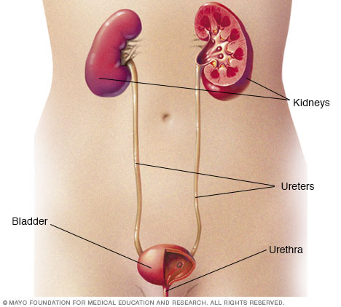
Causes / triggers
Female urethra is very short, proximity to bowel.
Post intercourse
Pregnancy, diabetes
Stones in urinary tract
Incomplete bladder emptying

Slide 35
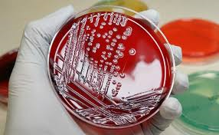
Investigations of recurrent UTIs
Culture of urine
Imaging of kidneys (usually Ultrasound scan) including post void residual scan
Flexible cystoscopy

Slide 36
Prevention of UTIs
Increase fluid intake
Effective bladder emptying
Urinate after intercourse
Wipe from front to back
Underwear with cotton gusset
Avoid irritation of the vagina with feminine hygiene products such as douches/sprays/strong soaps/scented liners
Use probiotics (lactobacillus), cranberry extract and vitamin C

Slide 37
Post menopausal UTIs
May be element of atrophic vaginitis – use vagifem pessaries
May benefit from urethral dilatation
May ultimately require prophylaxis based on sensitivities (watch duration of nitrofurantoin)

Slide 39
PSA

Slide 40
When to do a PSA?
Men >50 yrs of age (informed)
40 yrs of age if family history
Symptomatic LUTs (not if UTI, prostatitis, AUR)
Surveillance post CaP treatment (should be undetectable post RP, varies post RT)
Not in men >80 yrs of age (unless follow up or symptomatic)

Slide 41
Thank you
Questions?

