Slide 1

Let The Bugs Lie A While Longer:
Rural Doctors Conference October 2017
Martin Cormican, Galway University Hospital and National University of Ireland, Galway
Centre for Health from Environment
@cormican_martin and @healthfromenvir
Notes:
Ebola – the virulence of inequality and fear, a personal perspective.
Through much of 2014 an unprecedented outbreak of Ebola Virus Disease (EVD) has affected 3 countries in West Africa specifically Liberia, Guinea and Sierra Leone. Much of the rest of the world has been engaged in planning for the possibility of imported EVD and to a highly variable degree contributing to the control of EVD in the countries most affected. Most transmission has been along discrete identifiable chains among people who have had very close contact with EVD patients in life or death. Within Sierra Leone health care workers and the poor are among those most affected. Although the consequences of acquisition are profound it is not clear if Ebola is any more infectious than Staphylococcus aureus. There appears to have been some degree of conflation of the concepts of virulence and infectivity in much discussion. In fact EVD has most of the hallmarks of an easy to control communicable disease and it is significant that sustained transmission has been in the context of gross inequality, and profoundly dysfunctional systems of health care and governance. Much of the response to EVD in affected countries and globally has been characterised by irrational fear. As a consequence we have often looked on those potentially infected more as a problem to be contained rather than as a patients in need of care. The response of key institutions in Ireland with capacity to contribute (Health Service Executive, Department of Health, Universities) has been characterised by a focus on national self-interest with no effective mobilisation of resources to support response in affected countries. Periodic outbreaks of infectious disease with some potential for importation into Europe is part of the price we pay for our inability to address global inequality. It will always be difficult to confine infectious disease within the global ghettos of the poor.

Slide 2
If You Did This Today You Probably Got Poo On Your Hands
Do You Know How to Get it Off !

Slide 3
Summary
Clean Safe Care (Hand hygiene & other stuff)
CPE is bad
Urine Dip Sticks are a curse
Urine culture is mostly not a useful way to diagnose urinary tract infection
Breaking the “just in case” mould
We are this close to having untreatable infections
Do more HIV tests /Beware of dubious lab tests
Shigella is not what it used to be (think MSM)
Notes:
Jerome Brunner – The Narrative Construction of Reality

Slide 4
Three Websites
www.antibioticprescribing.ie
www.undertheweather.ie
http://www.hse.ie/eng/about/Who/QID/nationalsafetyprogrammes/HCAIAMR/hcailinks.html
Notes:
Jerome Brunner – The Narrative Construction of Reality

Slide 5
Overview
My new job
Other stuff
Notes:
Jerome Brunner – The Narrative Construction of Reality

Slide 6
My New Job
National Lead Healthcare Associated Infection and Antimicrobial Resistance
The Driver: Carbapenemase Producing Enterobacteriaceae (CPE)
Notes:
Jerome Brunner – The Narrative Construction of Reality

Slide 7
CPE: The Wider Context
Antibiotic/Antimicrobial Resistance
Antibiotic /Antimicrobial Resistance (AMR)
The Growing List of Acronyms: MRSA/ESBL/VRE

Slide 8
CPE: Why It Matters
54 Year Old Man Acute Pancreatitis. CPE acquired in ICU.
3 weeks later blood stream infection with CPE. Multiple antibiotics none of them ideal. He survived.
60(+) Year old man with lymphoma who needs an autologous stem cell transplant and has CPE
38 Year old woman. CPE acquired in India. Bladder infection. One kidney. Miserable. Looking a hospital admission for treatment of cystitis (maybe OPAT)

Slide 9
Doing Better on AMR
(National Plan Required by WHO)
1. Use Less Antibiotics (everywhere)
2. Get Better at Stopping the Resistant Bacteria From Spreading

Slide 10
Trying to Use Less Antibiotics
The message: antibiotics are bad for you unless you really need them
Generic
Diarrhoea, thrush and skin rash
Class Specific toxicity
Macrolide and Cardiac Toxicity
Fluoroquinolones – tendon damage, cardiac, epileptogenic
Notes:
Jerome Brunner – The Narrative Construction of Reality

Slide 11
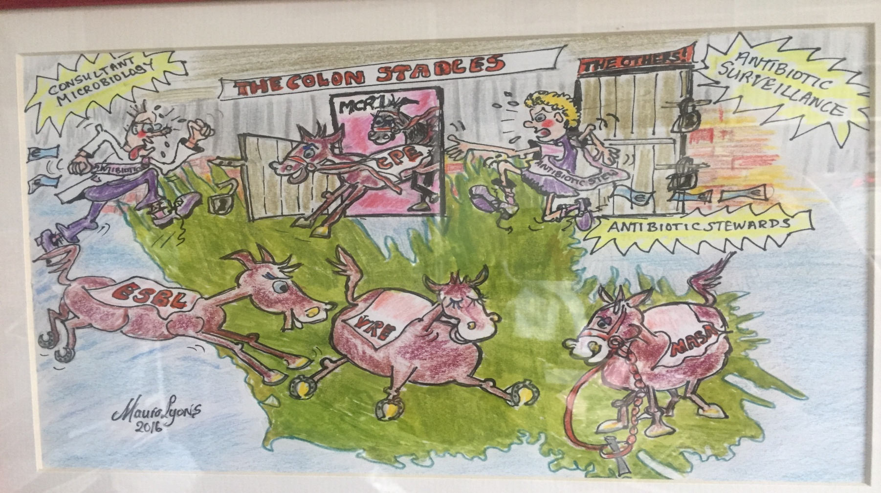
Status of AMR in Ireland

Slide 12
More about CPE
CPE – faecal oral spread
If someone got CPE they swallowed traces of someone else’s faeces
That should happen a lot less often in health care delivery than it does

Slide 13
CPE: What it is
First the E = Enterobacteriaceae
E: = normal gut bugs
E: a group of bacteria that belong normally in the gut (normal colonisation)
But: Can get into urine (cystitis/pyelonephritis), gall bladder (cholecystitis) and blood (blood stream infection/septicaemia)

Slide 14
E (=Gut Bugs) are Harder to Kill
1986 – pretty to easy to kill them when they cause trouble (co-amoxiclav with ceftriaxone as big gun)
1996 – getting harder to kill them (ESBL)
(ceftriaxone not so sure meroepenem as big gun)
2017 – sometimes nearly impossible to kill them (CPE)
(meropenem not sure – what is next big gun)

Slide 15
Now the C in CPE: What it is
C = Carbapenemase – an enzyme that destroys carbapenem antibiotics
Carbapenems (a family of antibiotics) meropenem is best know example

Slide 16
So CPE: What is it ?
C = Carbapenemase
P = Producing
E = gut bugs
(Term CRE widely used means more or less the same thing most of the time)

Slide 17
CPEs Come In Different Colours
(this is not an endorsement of smarties, Nestlé, or any other food high in refined sugar (although I do like smarties I like giant chocolate buttons even more but they are all the same colour so they were not suitable to illustrate this point)
OXA 48
KPC
NDM-1

Slide 18
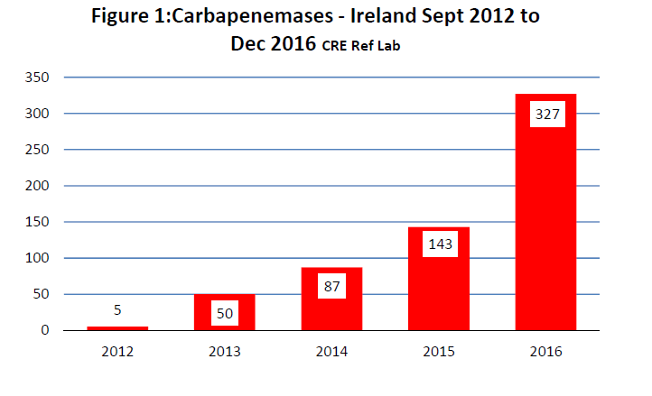
CPE: The Scale of What We Know About

Slide 19
CPE: A Different Kind of Pandemic
JM on the top floor has Escherichia coli CPE (OXA 48) January 15
MC on the second floor has Klebsiella pneumoniae CPE (OXA 48) February 1
PD on the ground floor has Citrobacater freundii CPE (OXA 48 February 17)
Three different bugs and no one is sick so what’s your problem ?

Slide 20
Summary of CPE
CPE is a creeping pandemic that is easy to overlook
You can’t see it spread if you are not looking (and we are not looking)
It is already shortening lives and costing misery and big money
We are paying and we will pay more – the choice
Pay now to try to control it
Pay in perpetuity for our failure

Slide 21
My New Job
The CPE gave the kick start
The agenda is much bigger – all HCAI/AMR
Acute Hospital and Community
If you have someone with CPE & need information
site
Notes:
Jerome Brunner – The Narrative Construction of Reality

Slide 22

One Health
Notes:
Jerome Brunner – The Narrative Construction of Reality

Slide 23
Overview
My new job
Some Other stuff
Notes:
Jerome Brunner – The Narrative Construction of Reality

Slide 24
Urinary Tract Infection ?
Nursing Home Resident age 84,
Background CVA
Nursing staff feel she is in bad form
Urine sample dipstick : nitrite positive
Urine culture: Klebsiella pneumoniae (ESBL)
Resistant to Ampicillin, Co-amoxiclav, Cefuroxime, Trimethoprim, Ciprofloxacin, Tazocin, Genatmicin
Susceptible to Nitrofurantoin and Fosfomycin
Notes:
Jerome Brunner – The Narrative Construction of Reality

Slide 25
Not Urinary Tract Infection
Asymptomatic bacteriuria
Very common
More common as one ages (males and females)
Best left alone
Even better don’t do the dip stick and don’t send the urine culture
Problems of treatment: C. difficile / Thrush / Antibiotic rash
Notes:
Jerome Brunner – The Narrative Construction of Reality

Slide 26
Asymptomatic Bacteriuria in Pregnancy
Current practice is to treat if confirmed
A recent Dutch paper raises a question
“In women with an uncomplicated singleton pregnancy, asymptomatic bacteriuria is not associated with preterm birth. Asymptomatic bacteriuria showed a significant association with pyelonephritis, but the absolute risk of pyelonephritis in untreated asymptomatic bacteriuria is low. These findings question a routine screen-treat-policy for asymptomatic bacteriuria in pregnancy.”
Notes:
Jerome Brunner – The Narrative Construction of Reality

Slide 27
Treating Urinary Tract Infection
Notes:
Jerome Brunner – The Narrative Construction of Reality

Slide 28
Treating Urinary Tract Infection
Notes:
Jerome Brunner – The Narrative Construction of Reality

Slide 29
Treating Urinary Tract Infection
Notes:
Jerome Brunner – The Narrative Construction of Reality

Slide 30
Treating Urinary Tract Infection
Notes:
Jerome Brunner – The Narrative Construction of Reality

Slide 31
Cystitis - ? Ibuprofen
SATIN Study (NUIG)
Symptomatic versus Antibiotic for Urinary Tract INfection
(Akke Velinga and Andrew Murphy et al. at NUIG)
Ibuprofen v nitrofurantoin for cystitis in adult women
Notes:
Jerome Brunner – The Narrative Construction of Reality

Slide 32
Pyelonephritis: Do Not Rely Too Much on Ciprofloxacin
Trends in E. coli invasive infections showing percentage resistance to fluoroquinolones, aminoglycosides and 3rd-generation cephalosporins
FQREC, fluoroquinolone (e.g. ciprofloxacin)-resistant E. coli; GEN, gentamicin, TOB, tobramycin; AMK, amikacin (GEN, TOB and AMK are aminoglycosides); 3GC, 3rd-generation cephalosporins (e.g. cefotaxime, ceftazidime)
* 2016 data are provisional to the end of Q2 only; ‡ 2015 missing data from 3 laboratories for 2 quarters each

Slide 33
Prophylaxis for Recurrent UTI
Nitrofurantoin is Not for Life
“Time Limited”
I would not use for more than 6 months (maximum)
Inclined to keep to 3
Pulmonary fibrosis / Hepatitis
Notes:
Jerome Brunner – The Narrative Construction of Reality

Slide 34
Lyme Disease
Lyme Disease:
Infection caused by Borrellia burgdorferi
Tick borne
Early Infection Erythema migrans (and othters)
Late Disease: neurological, joint, cardiac
Generally responds well to antimicrobial treatment
Notes:
Jerome Brunner – The Narrative Construction of Reality

Slide 35
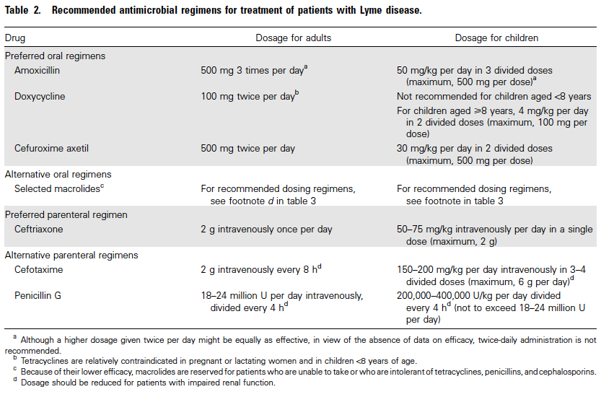
Lyme Disease : treatment options
Notes:
Jerome Brunner – The Narrative Construction of Reality

Slide 36
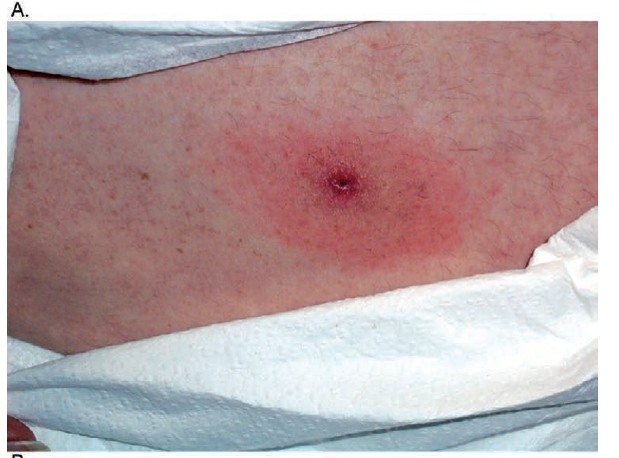
Lyme Disease: solitary erythema migrans
Notes:
Jerome Brunner – The Narrative Construction of Reality

Slide 37
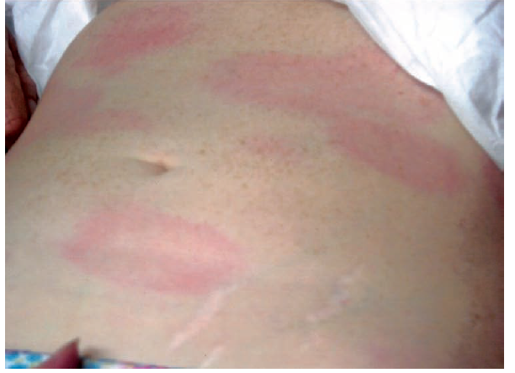
Lyme Disease: multiple erythema migrans lesions
Notes:
Jerome Brunner – The Narrative Construction of Reality

Slide 38
Lyme Disease: Testing
The tests
Screening Enzyme Immunoassay
Confirmation C6 EIA
IgG and IgM Immunoblot (PHE England)
Expect serology to be negative in erythema migrans
Notes:
Jerome Brunner – The Narrative Construction of Reality

Slide 39
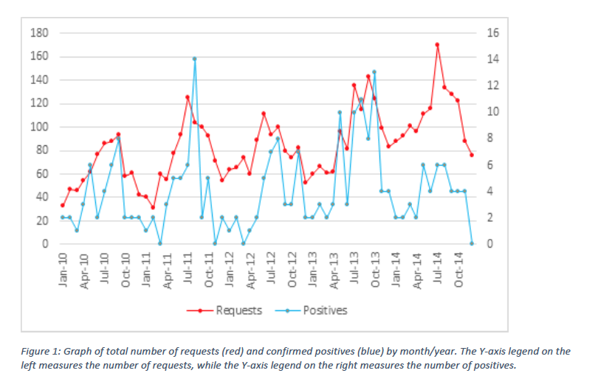
Change: a lot more testing but not really any more infection
Notes:
Jerome Brunner – The Narrative Construction of Reality

Slide 40
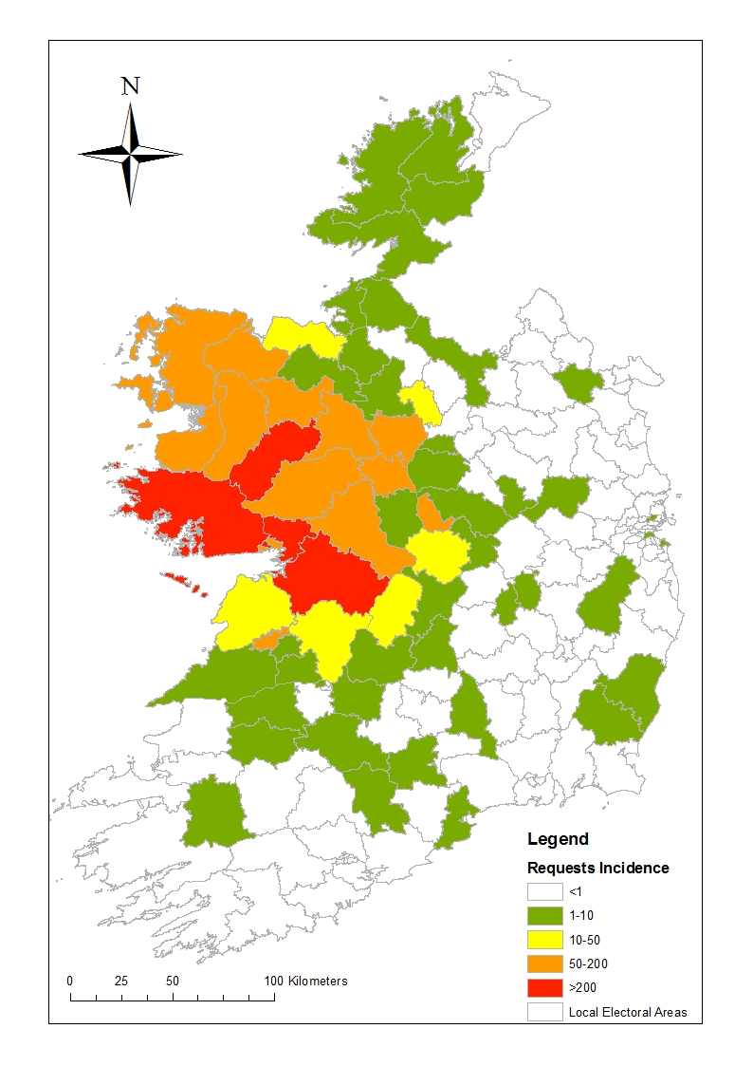
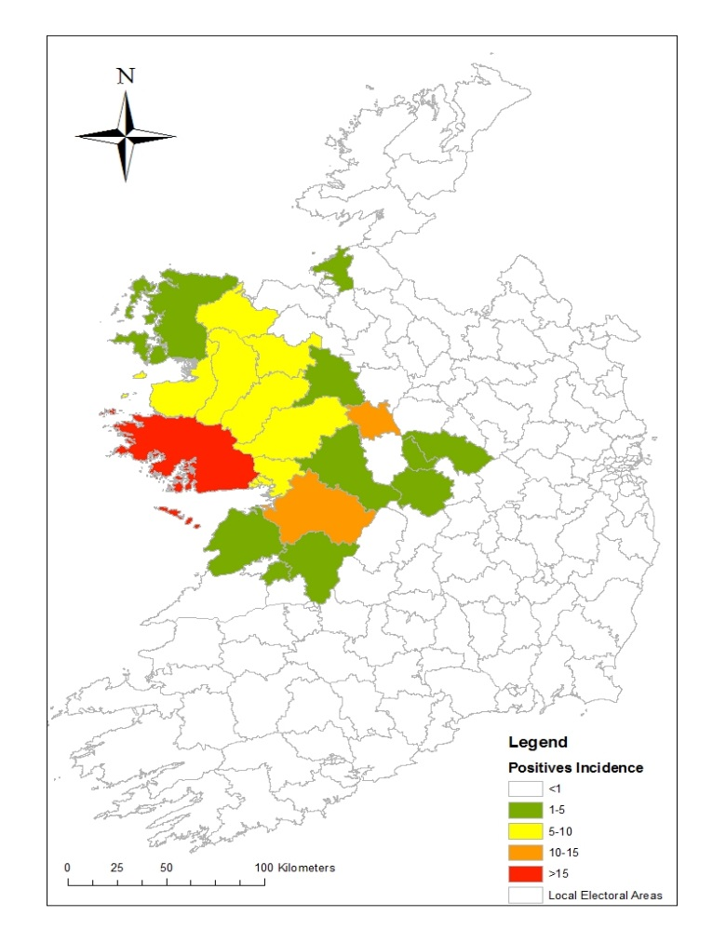
Average Incidence of Requests and of Positives by Local Electoral Area
Notes:
Jerome Brunner – The Narrative Construction of Reality

Slide 41
Change: a lot more testing but not really any more infection
Notes:
Jerome Brunner – The Narrative Construction of Reality

Slide 42
The Tick Bite & The Worried Father
Westdoc Call
Saturday Evening
He noticed a tick his son and took him to doctor to have it removed
Wants him to have antibiotics to prevent Lyme disease
Notes:
Jerome Brunner – The Narrative Construction of Reality

Slide 43
The Curse of faux Lyme Disease
Non-specific clinical features fatigue, headache, pain
( much like fibromyalgia/ ME )
Conventional diagnostics no evidence of B. burgdorferi or evidence of infection at some time
Fixed conviction that they have Lyme disease
Hostile to suggestion that there may be a pscyhological component
Present lab tests from Germany/USA
Notes:
Jerome Brunner – The Narrative Construction of Reality

Slide 44
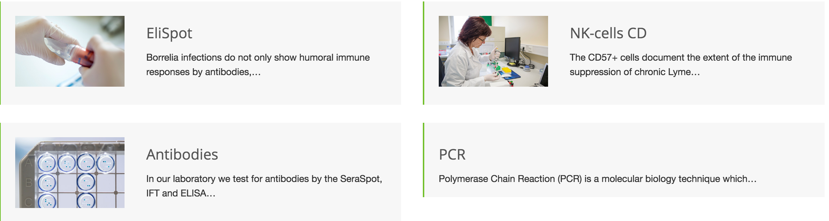
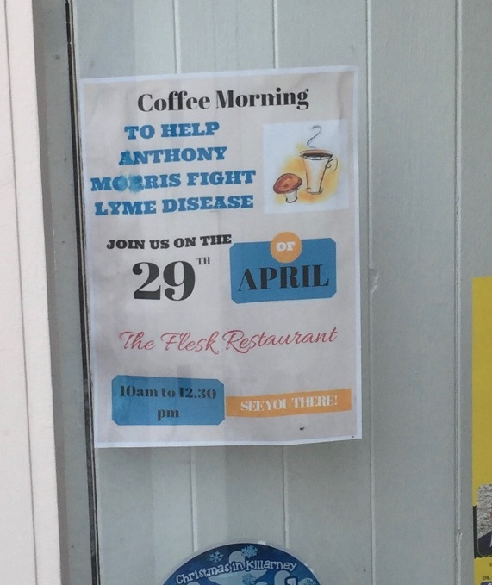
The curse of faux Lyme Disease & “the German lab”
Shop window
in Tralee
Notes:
Jerome Brunner – The Narrative Construction of Reality

Slide 45
The Curse of faux Lyme Disease
Management !
Practically if real serological evidence of infection at some time and persistent symptoms it is difficult not to treat but it does not do any good (there is a trial)
If no serological evidence of infection there is no rationale for treatment
Notes:
Jerome Brunner – The Narrative Construction of Reality

Slide 46
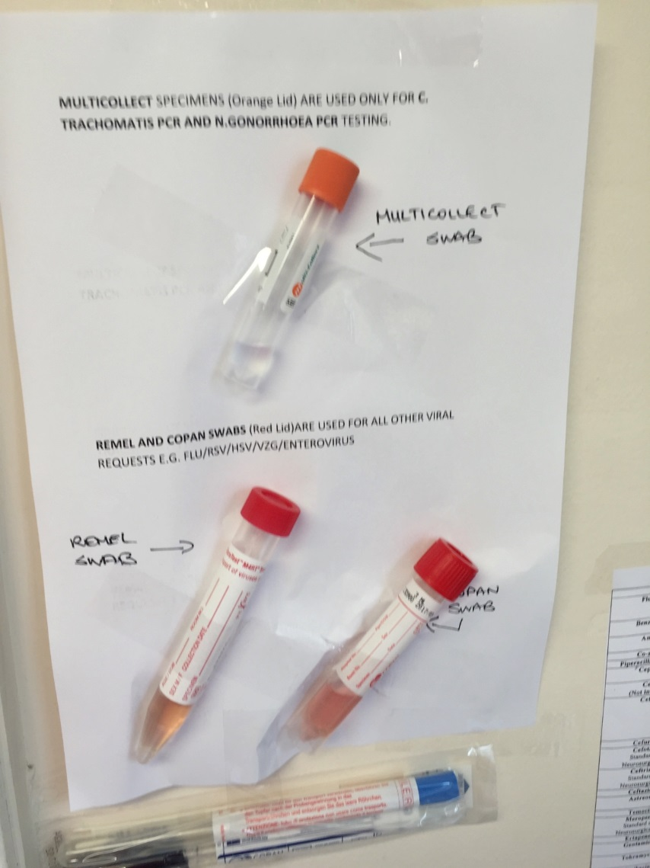
Changes in Testing: Molecular is Taking Over
N. gonorrhoeae and C. trachomatis
Molecular testing higher yield less time sensitive for transport
Though we still need to grow N. gonorrhoeae for susceptibility tests
Sorry we don’t accept urine samples from primary care
We Would Like To
Notes:
Jerome Brunner – The Narrative Construction of Reality

Slide 47
Changing Epidemiology
25 Year Old Previously Healthy Male
Sudden onset of abdominal cramps and diarrhoea (some blood) on Wednesday
No recent foreign travel was in Dublin for the weekend
Sample: Shigella/EIEC DNA detected
Shigella sonnei isolated (two days later)
Notes:
Jerome Brunner – The Narrative Construction of Reality

Slide 48
Changing Epidemiology
Think of MSM related STEI (Sexually Transmitted Enteric Infection)
If it needs antibiotic treatment – resistance is a big problem
Offer a HIV test; our threshold for testing is still too high
Consent for HIV testing – routine verbal consent
Notes:
Jerome Brunner – The Narrative Construction of Reality

Slide 49
Other Enteric Infection & Changing Epidemiology
Still mostly viral - Norovirus, Rotavirus and Adenovirus & others
Better at finding bacterial
Campylobacter is still most common bacteria
Ireland top of the league for Verotoxigenic E. coli (O157)
Vero-toxigenic E. coli (VTEC) = Shiga-toxigenic E. coli (STEC)
Ireland is near bottom of league for Salmonella
Notes:
Jerome Brunner – The Narrative Construction of Reality

Slide 50
Treatment Gastroenteritis
General rule is still to leave it alone mostly
But with exceptions:
severe, persistent, blood, systemically unwell
Salmonella: Treat infants, older people, aortic aneurysm, vascular graft, inflammatory bowel disease immunecompromised,
Shigella : high risk of onward transmission
Choice: Azithromycin 1g daily for 3
Ciprofloxacin 500mg 12 hourly for 3 days
Notes:
Jerome Brunner – The Narrative Construction of Reality

Slide 51
What Else ?
Head lice
Pin worms
Ekbom’s syndrome (delusional parasitosis)
Image 2
Image 3
Image 4
Image 1
Notes:
Jerome Brunner – The Narrative Construction of Reality

Slide 52
What Else ?
Image 2
Image 3
Image 4
Image 1
Notes:
Jerome Brunner – The Narrative Construction of Reality

Slide 53
Summary
Clean Safe Care (Hand hygiene & other stuff)
CPE is bad
Urine Dip Sticks are a curse
Urine culture is mostly not a useful way to diagnose urinary tract infection
Breaking the “just in case” mould
We are this close to having untreatable infections
Do more HIV tests /Beware of dubious lab tests
Shigella is not what it used to be (think MSM)
Notes:
Jerome Brunner – The Narrative Construction of Reality

