Slide 1
32ND Rural Island and dispensing Doctors Conference .Oct 2017
An Irish healthcare system where general practice is central to providing excellence in continuing personal care for all .ICGP strategic vision 2020

Slide 2
Visit to a country doctor. Norman Rothwell.
Notes:
Country dr with old values – listen to the patient , they are telling you the diagnosis
Use the family member test for communications and diagnostic pathways .
Understand that rural health is determined by wealth of the country and highest level of education in the family

Slide 3
Future of general practice

Slide 4
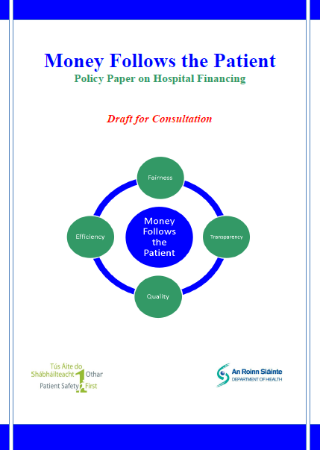
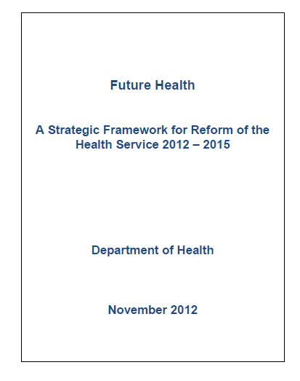
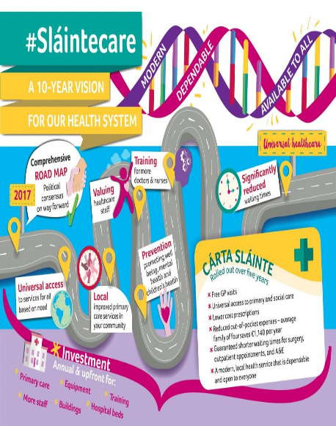
Drivers of change.
Notes:
16 years of reports & strategies !!

Slide 5
Politics , Bureaucracy, and competition.

Slide 6
No Ambiguity.
Reversal of FEMPI is priority
Policies and measures to secure and ensure the financial viability of General Practices in all their diversity.
Benefits to patients , Communities and their doctors.
Improved health outcomes : Reduced health inequalities
Financial stress affects health and productivity .
Notes:
Financial stress and doctors

Slide 7
Your college – Your membership.
A Professional Membership organisation –
Role of member
Role of faculty and faculty reps
Role of council
Role of board
Role of President- representative of organisation and members externally and internally and to ensure good governance
How well is your faculty functioning ?
Notes:
Individual GP have a role as members - to advocate and speak up on behalf of GP’ and to develop / support local faculty activity. As an essential building block of college and college policy . Strength in numbers .Debate the issues –Dont play the man . Debate and positive contribution to solutions. Don’t use social media
Does your faculty need support

Slide 8
Governance review
Organisational & Governance review
Financial controls-
External Board membership
Compliance with Company law
Faculty support\ Handbook
Membership Survey
Notes:
Clarity of decision making - Increased membership involvement . Compliance with corporate board responsibilty .

Slide 9
Current Projects
Transfer of GP Training – complex
CME- New Director –Protection of CME
Membership Survey and membership communications
GP recruitment- WWW. BEAGP.com
Chronic disease programmes – re-engagement
Complaint resolution \ feedback in practices

Slide 10
Your input
How can ICGP support you ?
Rural Group interests via Faculties or Via Rural and Island group?
NEGS / Locum /Cooperative assistants – Mentoring into faculty-
Euripa – expression of interest -representative
Hosting a Euripa conference - ? Interest –Volunteers
Notes:
Your college -your voice – be involved Return the survey . Contact College or me

Slide 11
Towards a new contract
Diversity and the Model for future care ?
Retaining GP as generalist and Specialist
General Practice at centre of healthcare

Slide 12
The Future of General Practice – The application of Business principles
Clarity: Clarity of strategy is key and growth tends to naturally follow.
Have we got a clear strategy and vision for General Practice
Talking about what you do: As well as doing brilliant work, it is very important to talk about it as this will maximise impact.
Negative comments from within the Specialty
Collaboration: The key tenet to success is collaboration.. Leveraging partnerships can make a significant difference.
HSE/DOH/Medical Council
Authenticity: Stay consistent to our values; Behaviour is crucial to everything, all else will follow.
Ambition: Institutions of all types should be stronger and aspire to be better.

Slide 13
Into the future
There is no consensus ( or evidence ) about future models of health care – nor should we expect one.
Acknowledge Diversity.
General practices, General practitioners , their Communities, & employment models
Mismatch of values
Notes:
Self employed , Partnerships Salaried - - single handed Group Rural v urban Deprived – deep end – V middle class gender balance changes
Mismatch of values –
Health planners plan for populations not for individuals

Slide 14
What is agreed ?
Chronic underfunding of general Practice
Workforce planning and underestimation of workforce gap
Undermining of General practice
No one size fits all model
Patients value the continuity and personal approach of traditional general practice
Notes:
David Oliver BMJ sept 2017

Slide 15
Clarity for the future
What general practice is really for ?
How its approach differs from the rest of medicine?
What parts require the skills of a doctor , as opposed to other staff, groups or self care ?
What are the gaps in social and community care which hamper good general practice ?

Slide 16
“Lets ditch the stuff we don’t need to do”.
Margaret McCartney BMJ Sept 2017

Slide 17
Success is the journey not the destination
Change is opportunity .
Be Leaders not victims
Doctors must lead this debate on creating an enabling environment and valuing professionalism , as a lever for quality health care.
Professionalism allows us to say ‘No’

Slide 18
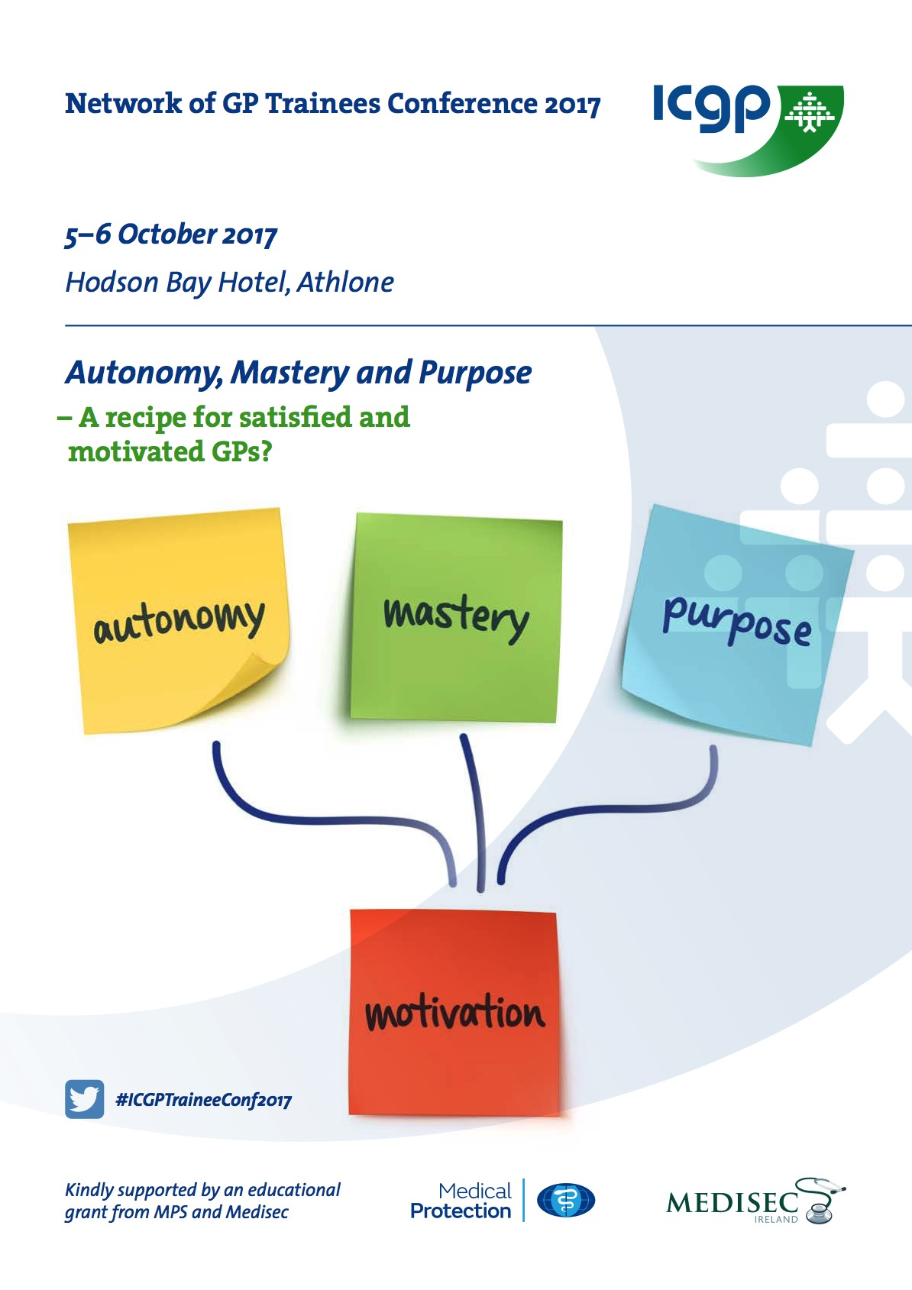
Notes:
Welcome conference theme – professionalism In addition for a satisfied GP career – all gp should have another passion or interest outside work

Slide 19
And what about…......... ?
Is medical education for General Practice fit for purpose ?
Overmedicalisation & Quaternary prevention
What age should a GP retire?
Quality & Sustainable workloads- Personal list size ?
Key relationships with :Hospital care: Private Health insurers
& Corporate health care
Private Patients– the 51%
Notes:
Whilst GMS is on everybodies list of priorities there are other professional issues we need to be discussing.

Slide 20
“One Size doesn’t fit all”
Notes:
Maybe

Slide 21
We all have more in common !
We must change the political discourse
Clear messages from all
Be aware and careful of unexpected consequences
Notes:
eg pushing more work to Hospital hospital strengthens their hand for more control , outreach and funding.

Slide 22
Thank you
I’m not just a GP, I am a specialist in life. (RACGP )
Please Contact at: Richard.Brennan@icgp.ie

Slide 23
Prevention and risk factorology .

Slide 24
The Future of Irish General Practice Survey 2015
90% of GPs feel that communication between the Government and GPs has failed both doctors and patients
47.3% of GPs describe their morale as poor or very poor and for 77.6% their
morale has worsened over the past five years
74% of GPs rated their current stress levels as high or very high
55.3% of GPs who tried to recruit a sessional doctor/assistant in the past year were unable to do so
Only 44% of GPs who tried to recruit a locum in the past year were able to do so on more than half of the occasions that they tried
Rural GPs were less successful in terms of recruiting sessional/assistants or locum cover
The majority of GPs consider that free GP care to the under 6s and over 70s will impact on waiting times in general practice
Just over one third consider that free care to the over 70s will result in improved monitoring of health needs
Almost two-thirds of GPs support the principle of primary care teams (PCT) although only 13% consider they are currently working in a well-functioning PCT
Notes:
ICGP survey 2015

Slide 25
2015 Survey (Cont.)
Less than one quarter of GPs indicated a preference for co-location with a PCT
Over two-thirds of GPs welcome chronic care management models of care and
the majority (86.8%) agreed that moving care from secondary to primary care will benefit patients. However, this was contingent on appropriate supports and resources being put in place.
GPs highlighted the importance of preserving factors such as continuity of care, the doctor patient relationship and person centre care.
Notes:
1)Survey highlights high stress levels and low morale 2

