Slide 1
GP Audit Solutions
Dr. Frank Fogarty GP Inishowen Donegal

Slide 3
Background
What is Clinical Audit
Audit Cycle/Loop
How to successfully carry out an Audit
How to write it up
Potential Audit Topics
Audit Adaptation for different GP Working Circumstances

Slide 5
Background
Part 11 of the Medical Practitioners Act 2007
Implemented May 2011
“In order to comply with the requirements of competence assurance,it is obligatory for every practicing GP to conduct at least one audit per year”

Slide 6
What is clinical audit ?
“Systematic review and evaluation of (our) current practice with reference to research based gold standards to improve (our) patient care”
It’s a quality improvement process
Seeks to determine if we are doing what we should be doing

Slide 7
Audit Cycle/Loop

Slide 8
How to carry out an Audit
Choose your topic- worthwhile/group concensus,usefull to choose something you are unsure of current practice,an area where you feel your practice needs improvement
Define your Aims and Objectives

Slide 9
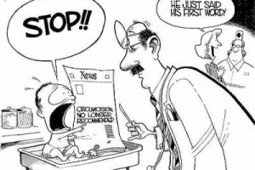
Choose your Guidelines-state your Criteria(elements of care or activity) and set your Standard(targets-percentages)
The Irish College of GPs www.icgp.ie
The Royal College of GPs www.rcgp.org.uk
National Institute for Health and Clinical Excellence www.nice.org.uk
Scottish Intercollegiate Guidelines Network www.sign.ac.uk

Slide 10
Collect your data-either manually or use your practice Management Software,all the certified products such as Helix Practice Manager,Soccrates etc have the ability to find pts with particular diseases once these have been coded.If not coded can do a relevant drug search.With Helix-Reports/Drug/New/Prescribed from/prescibed to/age range/gender/show/add/run
Analyse and interpret your data
Decide on what changes need to be made and implement them
Re-Audit your practice

Slide 11
Writing up the Audit
May be as short as 2 pages in length
1.Reason for the Audit
2.Criterion or criteria to be measured
3.Standard(s) set
4.Description of the preparation and planning(12 hrs/yr)
5.Results of the initial data collection

Slide 12
Example of data collection(1) presentation
The initial data collected should be presented using simple descriptive statistics in table format or using graphs.Remember to quote actual numbers (n) as well as percentage(%)
Criterion | No of MI patients (n) | No contra-indicated | No of patients on aspirin | Standard(%)
Patients with a previous MI should be prescribed aspirin,unless containdicated | 53 | 3 | 30/50 60% | 80%

Slide 13
Writing up the audit
6.Description of change(s) implemented
7.Results of the data collection post changes
8.Conclusions-Briefly and simply summarize what the audit achieved and what were the main learning points gained from the exercise

Slide 14
You are being judged on your understanding of audit and not your knowledge of sampling techniques or complex stats

Slide 15
Potential Audit Areas
Core Chronic Disease Audits
Prescribing guidelines
Workload and Administration Audits
Miscellaneous Audits-” The Drs Bag”,”ICGP Rep””Coroner reports” etc

Slide 16
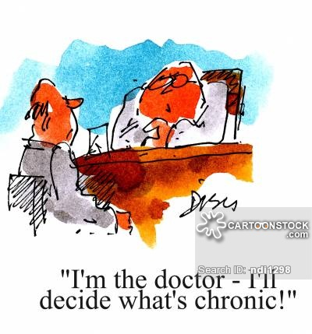
Core Chronic Disease Audits
Asthma
CAD
Hypertension
Diabetes
Coeliac

Slide 17
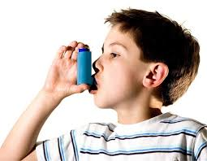
Asthma-SIGN/GINA Guidelines Criteria
Pts should be assesed at least once every 12mths
Pts should have inhaler tech checked annually
Should have flu vaccine
Should have smoking status recorded
Should not be on Bblockers or NSAIDS

Slide 18
Secondary Prevention of CAD following MI-SIGN Guidelines
Should be prescribed Aspirin unless c/I
Should be on a BBlocker unless c/I
Should be on an ACE
Should be on lipid lowering therapy
Should have smoking status recorded
Should have BP taken and recorded annually
BP should be <140/90

Slide 19
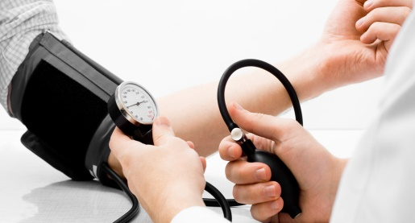
Hypertension
Hypertensive patients should have an annual U/E
Should have annual urinalysis check for proteinuria
Should have an individualised target BP noted on file
Should have a BP reading at least annually

Slide 20
Diabetes
Should have HBAIC checked every 12 mths
Should have lipids checked every 12 mths
Should have eGFR checked every 12 mths
Should have their urine checked for proteinuria
Should have BP checked
Should have smoking status recorded,feet checked,fundoscopy,BMI,Diet/Exercise advice etc…..

Slide 21
Coeliac Disease-ICGP Guide 2015
Pts with sxs,signs of malabsorption such as chronic diarrohea should be tested for Coeliac disease
Pts with a 1st Degree Relative should be considered for testing
Pts with newly diagnosed Coeliac should be tested for B12/Folate/IDA
All pts should have a DXA scan at presentation
All pts should be reviewed annually
All pts should be referred to a Dietician

Slide 22
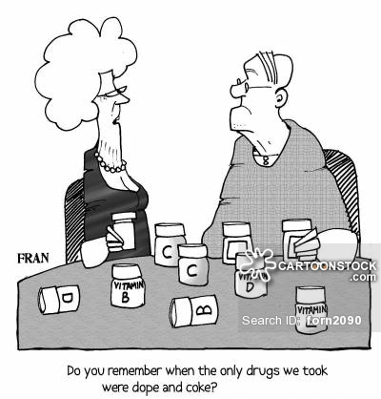
Prescribing Guidelines
Uncomplicated UTIs in Adults
Methotrexate
Lithium
Warfarin

Slide 23
Uncomplicated UTI in Adults-SARI
A/Bs should be used in line with SARI guidelines Trimethoprim 200mg bd or Nitrofurantoin 50-100mg qid
Courses should be 3 days in women,7 days in men
All a/bs prescibing should be accompanied by a check for known phx of hypersensitivity and this should be recorded in the notes

Slide 24
Methotrexate/lithium/Warfarin-BNF Standard
Methotrexate –should have blood tests every 2-3 mths
Both day of week and tablet strength should be specified on the script
Folic acid should be co prescribed + day of week stated
Should have annual influenza vaccine + Pneumococcal per schedule
Pt education regarding the hazards of MXT and sxs and signs of toxicity/overdose should be given and documented

Slide 25
Workload and Administration
Surgery Start and End Times
Referral letters for OPD/ED etc
Written reports for Insurance Agencies/SW
Laboratory and Radiology results
Waiting time in surgery !

Slide 26
Surgery Start and End Times
Criteria
Surgeries should start within 5 mins of their intended start times
Surgeries should end within 20 mins of their intended finish time
Data collection over 2 wks(10 working days)-eg over a 2wk period Dr X started 25 surgeries within 5 mins of intended time out of a total of 30 surgeries,therefore percentage compliance is 25/30 x 100=85% which should be compared with the standard set

Slide 27
Referral Letters-SIGN Guideline 31
Criteria
Routine GP referral letters should be sent within 3 working days
Routine GP letters should contain adequate information on hx of presenting complaint,current/recent medication.pmhx ,allergies and expectation of outcome of referral

Slide 28
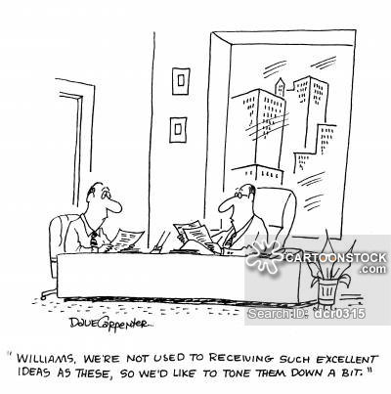
Written Reports for Insurance Agencies/SW
PMA should be typed and sent within 14 (10) working days
SW reports should be sent within 14 (5) working days

Slide 29
Laboratory and Radiology Results
Criteria
Lab and Radiology reports should be reviewed by the Dr within 3 working days of receipt
Lab and Radiology reports that have been reviewed by the Dr should be filed in the patient’s record within 5 working days

Slide 30
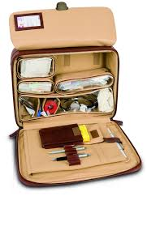
Miscellaneous Audits
GP Emergency Bag- BNF Criteria
GP bag should contain a supply of in-date aspirin
GP bag should contain a supply of in-date Adrenaline
GP bag should contain a supply of in-date IV Benzyl Pen and water for injection
GP should contain a supply of in-date Glucagon

Slide 31
Acting as an ICGP REP
Criteria
Do you know the name and contact details of the link person in the ICGP who you will liase with on all matters relating to this role Y/N
Do you have a copy of the ICGP annual report Y/N
Have you completed the ICGP conflict of interest declaration Y/N
Do you have a copy of all meeting minutes Y/N
ETC…

Slide 32
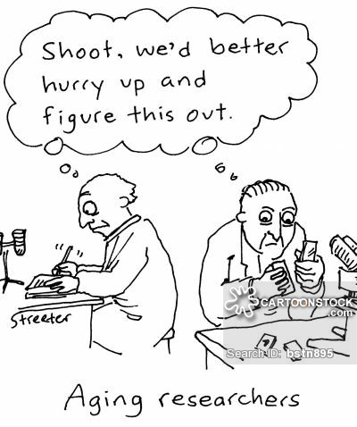
Audit adaptation for Different GP working Circumstances
Sessional
Out of Hrs
Locum
Semi retired

Slide 33
SARI Guidelines for Antimicrobial Prescribing in Primary Care
Review the last 30 relevant patients re any two of the criteria below
All a/b prescribing should be accompanied by a check for known phx of hypersensitivity and this should be recorded
All a/b prescribing should be accompanied by a check for potential drug interactions and this should be recorded
A/Bs should be used in line with the guidelines

Slide 34
If any a/b started at time of diagnosis-was indication recorded in the notes
If a second line a/b is used,the reason for its use should be documented

