Slide 1
Do Not Resuscitate & Power of Attorney end of life issues for gp’s Dr Cathryn Bogan Consultant in Palliative Medicine

Slide 2
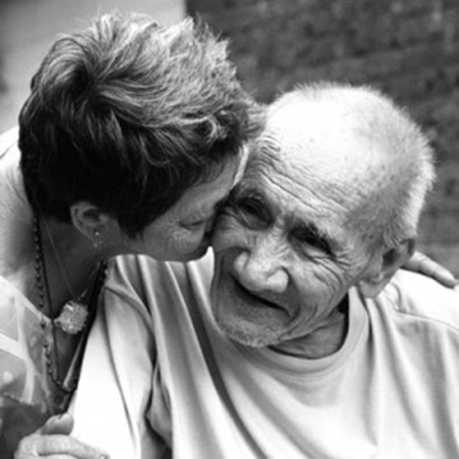
POA
Assisted decision making act (capacity) act 2015
Advanced healthcare directives
Resuscitation
Society
Discussions
Documentation
Disagreements
Questions

Slide 3
Power of Attorney

Slide 4
Power of Attorney (POA)
Specially appointed person (the attorney) to take actions on the person’s (the donor's) behalf if he/she is absent, abroad or incapacitated through illness.
If someone in Ireland is mentally incapacitated, all of their assets and property are normally frozen and cannot be used by anyone else unless they are jointly owned or, someone has power of attorney to deal with their property or money.
Specific
sale of your house in your absence
General
entitling the attorney to do almost everything that you
yourself could do

Slide 5
Enduring power of attorney (EPA)
Allows the attorney to make "personal care decisions" on the donor's behalf once he/she is no longer fully mentally capable of taking decisions themself.
Personal care decisions
where and with whom the donor will live
who he/she should see or not see
what rehabilitation he/she should get.
Appoint anyone you wish to be your attorney, including a spouse, civil partner, family member, friend, colleague, etc. procedure for creating an EPA is much more complex than that for creating a general POA.
Both cease on the death of the donor.
Solicitor and doctor

Slide 6
Assisted Decision Making (Capacity) Act 2015 statutory framework for individuals to make legally-binding agreements about their welfare property and affairs assist and support in making decisions

Slide 7
Advance Healthcare Directives
Assessing capacity
understand the information relevant to the decision,
retain that information long enough to make a voluntary choice,
use or weigh that information as part of the process of making the decision,
communicate his or her decision in whatever way they communicate (not only verbally)
Person should NOT lack capacity if
Require information to be explained to them in a way that is appropriate to their circumstances
Can only retain the relevant information for a short period
People may lack capacity for some decisions but have capacity for others

Slide 8
Assisted Decision Making (Capacity) Act 2015
Signed into law on the 30th December 2015.
Not yet been commenced.
It applies to everyone and to all health and social care settings.
Right of autonomy and self-determination to be respected
Enduring Power of Attorney
Advance Healthcare Directive – made when a person has capacity- to come into effect when they may lack decision-making capacity.
Legally recognised decision-makers to support a person maximise their decision making powers.
legal requirement on service providers to comprehensively enable a person make a decision through the provision of a range of supports and information appropriate to their condition.

Slide 9
Assisted Decision Making (Capacity) Act 2015
Decision making supports (welfare, property and affairs)
Assisted decision-making
Assistant- cannot make the decision for the person
Co-Decision Making
Appoint someone to jointly make decisions
Decisions by the court (decision –making representative)
Abolishes the Wards of Court system
Decision Support Service with clearly defined functions which will include the promotion of public awareness relating to the exercise of capacity by persons who may require assistance in exercising their capacity.
The Director of the Decision Support Service will have the power to investigate complaints in relation to any action by a decision-maker in relation to their functions as such decision-maker.

Slide 10
Advance Healthcare Directives
Decisions on future medical treatment in writing and witnessed.
A person will be able to revoke an AHD at any time – verbally or in writing.
No-one will be under any obligation to create an AHD
‘designated healthcare representative’- acting on the person’s behalf at a time when they lose capacity. also be given a general power to consent to and to refuse treatment up to and including the refusal of life-sustaining treatment
An AHD only comes into force when a person loses capacity and cannot make a decision.
An AHD provides clarity
Healthcare professionals to care for a person
Family

Slide 11
Medical council
Advance healthcare plan or directive- Valid if:
an informed choice and the person had capacity
the decision covers the situation that has arisen
nothing to indicate that the patient has changed their mind
Designated
Guide to Professional Conduct and Ethics for Registered Medical Practitioners
8th Edition 2016

Slide 14
Palliative care
Advance care planning
Medical interventions
Place of care

Slide 15
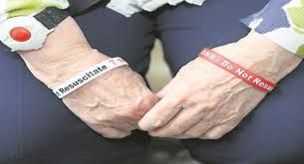
Do not attempt resuscitation
Society
Discussions
Documentation
Disagreement

Slide 16
Society perceptions

Slide 17
Guide to Professional Conduct and Ethics for Registered Medical Practitioners 8th edition
End of life care
comfortable, suffer as little as possible and die with dignity. You should treat them with kindness and compassion
Communicating with patients and their families is an essential part of good care
Sensitive in presenting information, but make sure that patients and their families have a clear understanding of what can and cannot be achieved. You should offer advice on other treatment or palliative care options that may be available to them. You should make sure that support is given to patients and their families, particularly when the outcome is likely to be distressing for them

Slide 18
Guide to Professional Conduct and Ethics for Registered Medical Practitioners 8th edition
End of life care
Usually, you will give treatment that is intended to prolong a patient’s life. However, there is no obligation on you to start or continue treatment, including resuscitation, or provide nutrition and hydration by medical intervention, if you judge that the treatment:
is unlikely to work; or
might cause the patient more harm than benefit; or
is likely to cause the patient pain, discomfort or distress that will outweigh the benefits it may bring.
You should carefully consider when to start and when to stop attempts to prolong life. You should make sure that patients receive appropriate pain management and relief from distress, whether or not you are continuing active treatment.

Slide 19
Discussions about DNAR

Slide 20
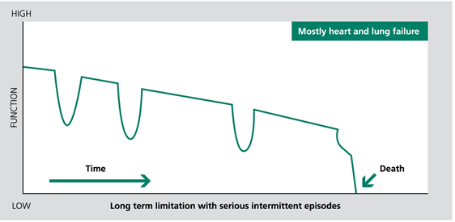
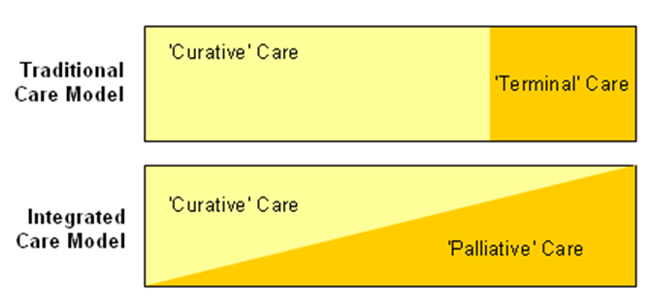
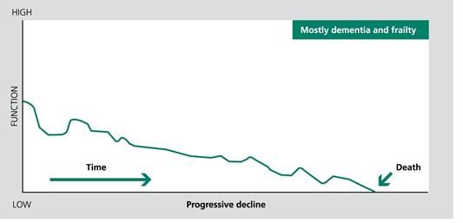
prognosis

Slide 21
Discussions
CPR may not be appropriate but other active treatments maybe

Slide 22
Discussions
Cardiopulmonary arrest
Unlikely
Inevitable
Sensitive , open discussion about end of life care, helping patients to understand severity of their illness
This does not necessarily require explicit discussions of CPR/DNAR
Possible/likely
ACP inc DNAR should occur in the context of discussion about prognosis

Slide 23
Discussions

Slide 24
Documenting DNAR

Slide 25
documentation
Hospital and Hospice
Policy
Specific form

Slide 27
documentation
Nursing homes
Community Hospitals
Supervised residential unit
Transfer of information between institutions
Ambulance letters stating DNAR
Discharge letters
Home

Slide 28
disagreement
Between the healthcare team and the patient or the patient’s family about whether it is appropriate to withdraw treatment, or not to start a treatment, you should make every effort to resolve the issue.
You should explain the reasons for your decision and listen carefully to the views of others.
If an agreement cannot be reached, you should consider seeking advice from an experienced colleague, getting a second opinion, involving an independent advocate, or using a mediation service if available.

Slide 29
Communicating diagnosis
Giving a prognosis
Explaining a DNAR
Number of complaints
Families confused about what it means
Families confused about who has the right to decide
Patient autonomy
Patient told of terminal illness without offering to have family or staff present

Slide 30
summary
POA
Assisted decision making (capacity) Act
Designated healthcare representative
Formal documentation
Advanced healthcare directives
DNAR
Discussions
Documentation
Transfer of this information across healthcare settings inc ambulance
Disagreements

Slide 31
Questions?

Slide 34
