Slide 1
Clinical imaging in a general practice setting
Dr Tommy Lynch
Mb Bch BAO MICGP

Slide 2
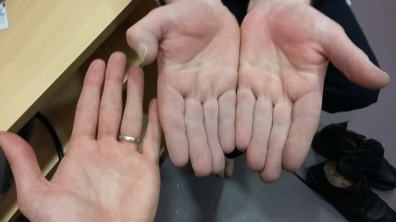
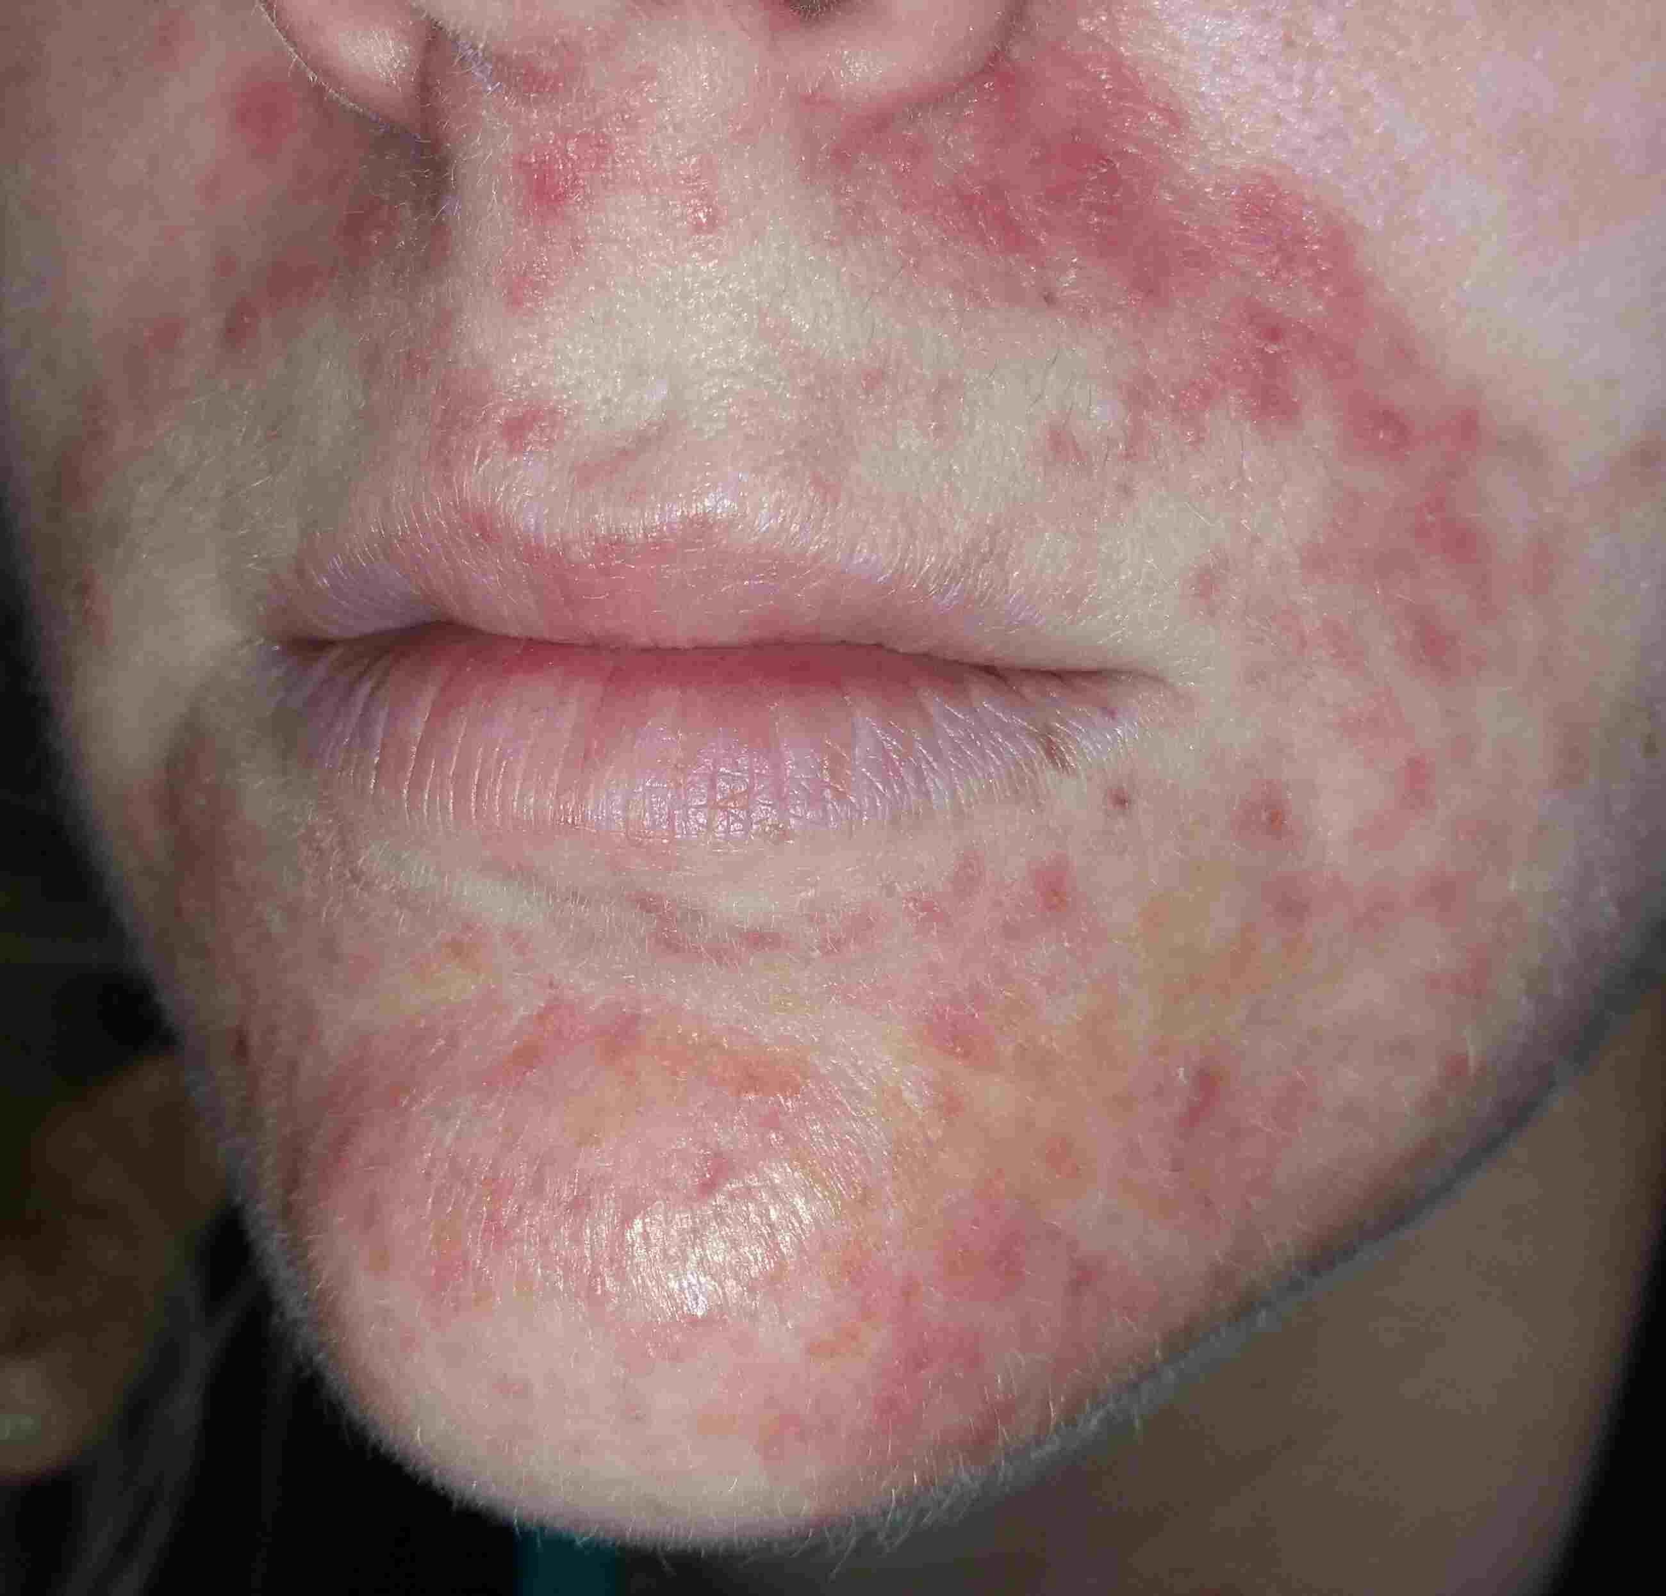
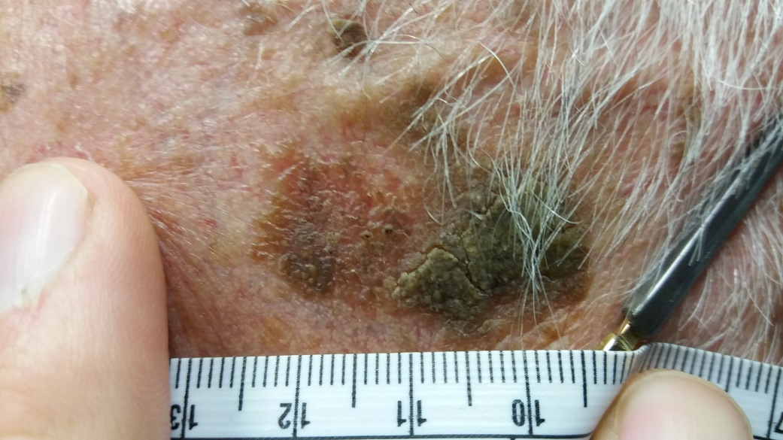
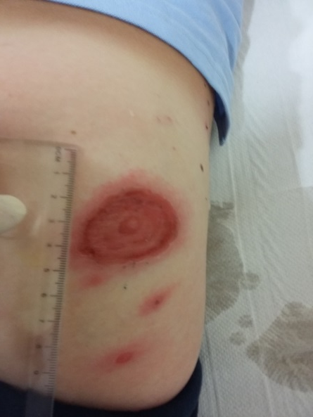
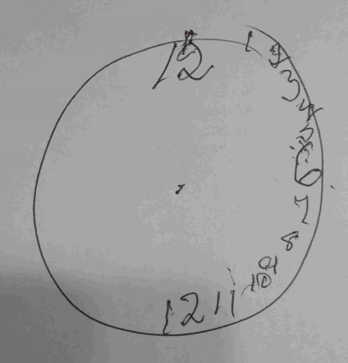
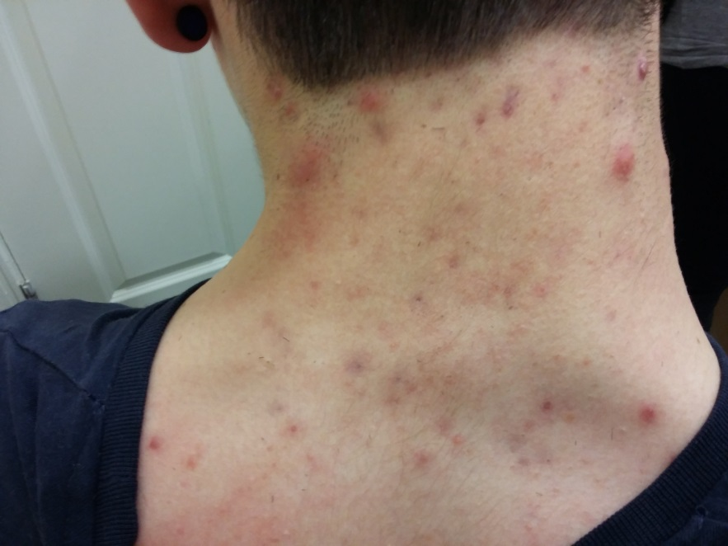
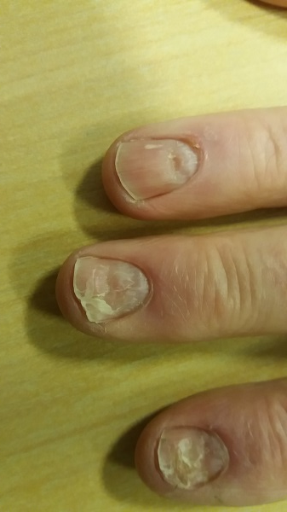
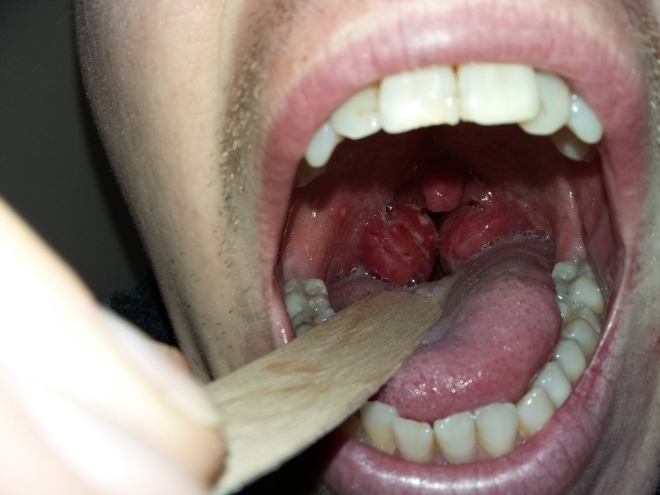
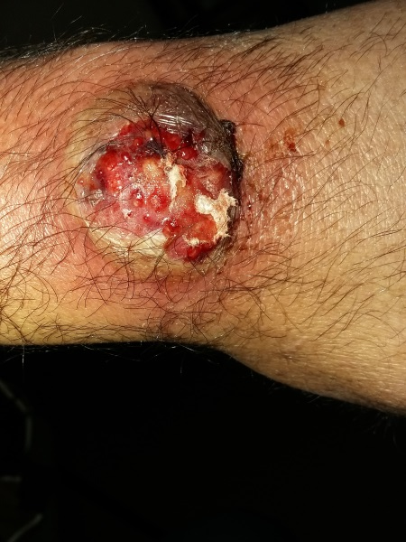

Slide 3
Photography and me
Sligo gp training scheme
GP research project
“phlue”
Snap GP

Slide 4
Issues became clear
Camera?
Consent?
time
Transfer of the image
technical
Data trail
Is there a better way?

Slide 5
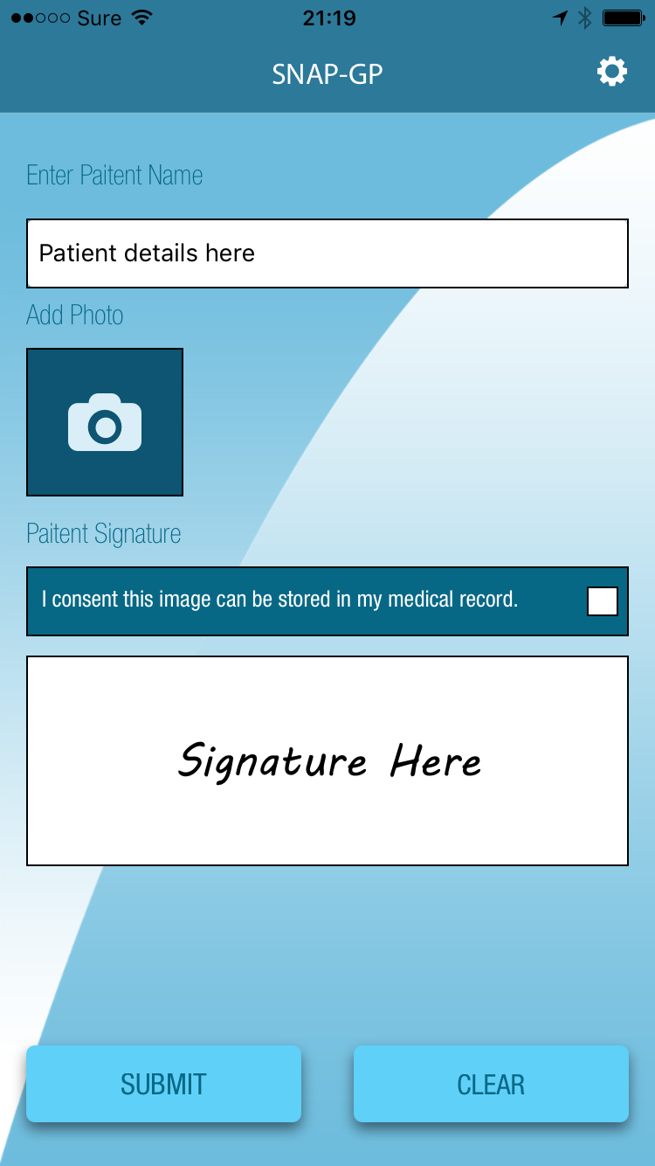
Trying to innovate
Form a company
Employ an IT consultant and developer
Create what I wanted to use
Consent
Simple quick and very safe
Improve care for patients of all GPs
Make photography more accessible to GPs

Slide 6
What does Snap GP do
Takes a picture – patient signs the consent screen
Name and signature embedded on image
Image is sent via secure cloud (not saved in the cloud)
Lands in a designated folder on your work desktop
Automatically deletes from phone
Easily uploaded to patient file

Slide 7
What next?
Continue testing Snap GP app
Videos for GPs “how to upload the image from folder to patient consultation note” for both socrates and healthone
Look for feedback from GPs to improve
Tweet/follow
@phluephotos
Email
tommy.lynch.Ireland@gmail.com
Call
+44 7 624 473 571

Slide 8
Thank you

