Slide 1
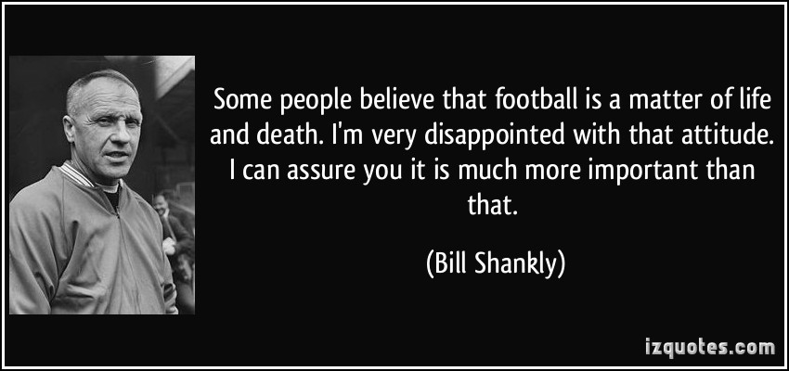
Guidelines for Concussion management in Sport Rural Drs Meeting –Clifden 2016
Dr Frank Fogarty GP Dip MSK Med, M.Med.Sc. FFSEM

Slide 2
Concussion
What is it?
Why is it important?
How to recognise it?
What to do pitchside?
What to do later?
When to allow play again?
Children < 13 yrs olds ?
The future?

Slide 4
Concussion- What is it ?
“A complex Neuro PathoPhysiological proccess affecting the brain,induced by traumatic biomechanical forces”
-Functional disturbance rather than structural injury
-Temporary loss of brain function
-Most occur without LOC
-An evolving injury
-Diagnosis is a clinical judgement

Slide 5
So whats that in laymans terms?
It’s a violent jarring or shaking of the brain
It is temporary
usually doesn’t pass out
It may develop over time
You don’t need a Scan to Diagnose it
It is diagnosed by what you see and hear

Slide 6
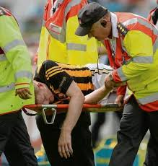
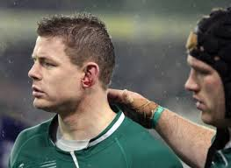
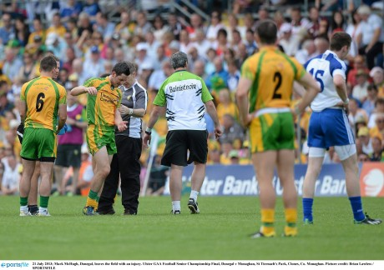

Slide 7
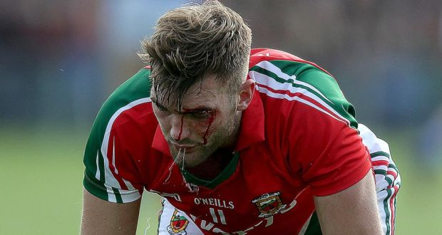

Slide 8
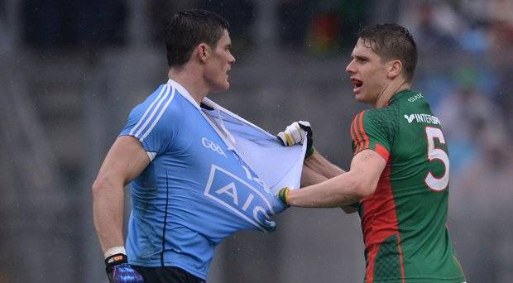

Slide 9
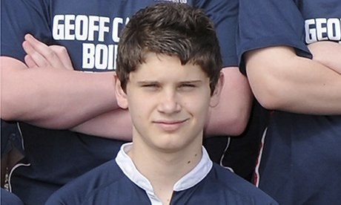
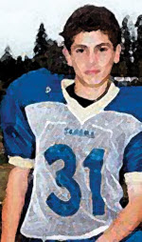
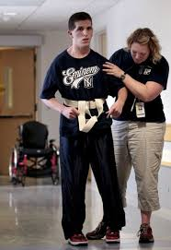

Slide 10
How common is it?
Sport Concussion rate/1000
player hours
Horse Racing(A) 95.2
Horse Racing(Jumps) 25.0
Boxing (professional) 13.2
Rugby Union(Pro) 3.9(1:6 games)
Rugby Union(Amateur) 1.2(1:21 )
Soccer FIFA 0.4 (1/season)
NFL Football (NFL) 0.2

Slide 11
How to Recognise It?
Symptoms
“feeling in fog”
dazed
Headaches
Dizziness
Physical Signs
Vacant facial expression/clutching head/motor in coordination/vomiting/loc

Slide 12
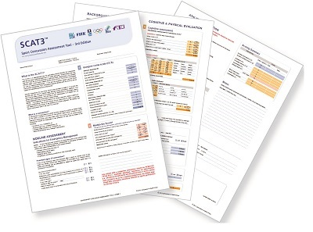

Slide 13
SCAT 3-Part 2
Do 10 mins post rest period to avoid influence of exertion and fatigue on assessment
Symptom Evaluation
Cognitive assessment
Neck Examination
Balance examination
Coordination examination
Delayed Recall

Slide 16
Later recognition ?
Cognitive Impairment-loss of short term memory/difficulty concentrating/decreased attention/Diminished work performance
Behavioural Changes- irritability/anger/mood swings/feeling nervous/anxious
Sleep disturbances-Drowsiness/difficulty falling asleep

Slide 17
What to do pitchside

Slide 18
What to do Pitchside?
SCAT 3 Assessment-Part 1
Pocket Concussion Recognition Tool
Exclude cervical injury
Outrule structural brain injury-Quick GCS(Best eye response/best verbal response/best motor response)
Look for potential signs of concussion
Maddocks Score

Slide 19
So whats a Maddocks score
Is it really complicated to do ?

Slide 21
So whats the most important intervention you can do?

Slide 22
REMOVE FROM PLAY DO NOT ALLOW BACK

Slide 23
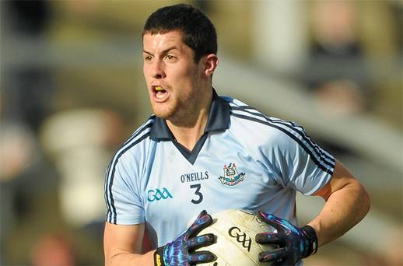
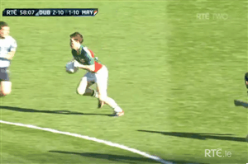
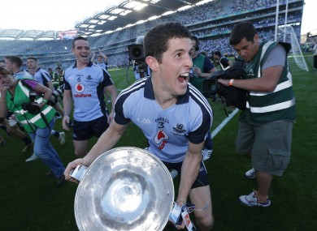
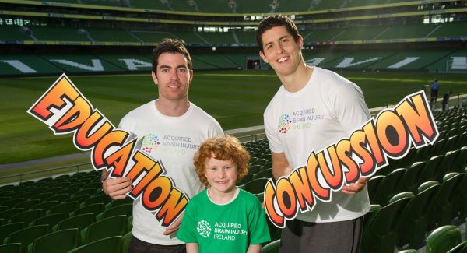

Slide 24
What to do Later
Concussion advice leaflet
Advise Rest (Cognitive and Physical)
Avoid Alcohol
Avoid OTC medication
Red Flag Sxs
Explain Return to Play Protocol

Slide 26
Gradual Return to Play Protocol

Slide 27
Children <13 yrs
Concussion management different due
Brain development,
variable growth rates,language difficulties,child v parental reports of sxs
Child SCAT 5yrs-12 yrs
Rest for min 2/52 with gradual return to school as well as play

Slide 29
Concussion
What is it?
Why is it important?
How to recognise it?
What to do pitchside?
What to do later?
When to allow play again?
Children < 13 yrs olds ?
The future?

Slide 30
The Future
Better protective equipment
Risk compensation
Lystedt Law
Rule Changes
“The Head Bin”
Medicolegal Implications
EDUCATION

Slide 31
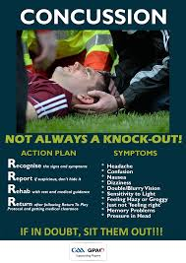

Slide 32
The Future
Zurich Consensus Statement on Concussion 2012
Berlin Oct 2016
Evolving Science
Better Neuro Imaging Techniques fMRI scans
?Link with Chronic traumatic encephalopathy

Slide 33
Resources
Concensus statement on concussion in sport:the 4th International Conference Zurich 2012 BJSM 2013 47:250-258
Concussion Guidelines in the GAA 2013-2016 GAA Medical,Scientific and Welfare Committee 2013 Ruth Phelan
www.gaa.ie/medical-and-player-welfare/injuries/concussion
www.irishrugby.ie/medical
SCAT 3 Assessment tool
Child SCAT 3

