Slide 1
The Exceptional Potential of Each General Practice
Dr Niall Maguire
Navan

Slide 2
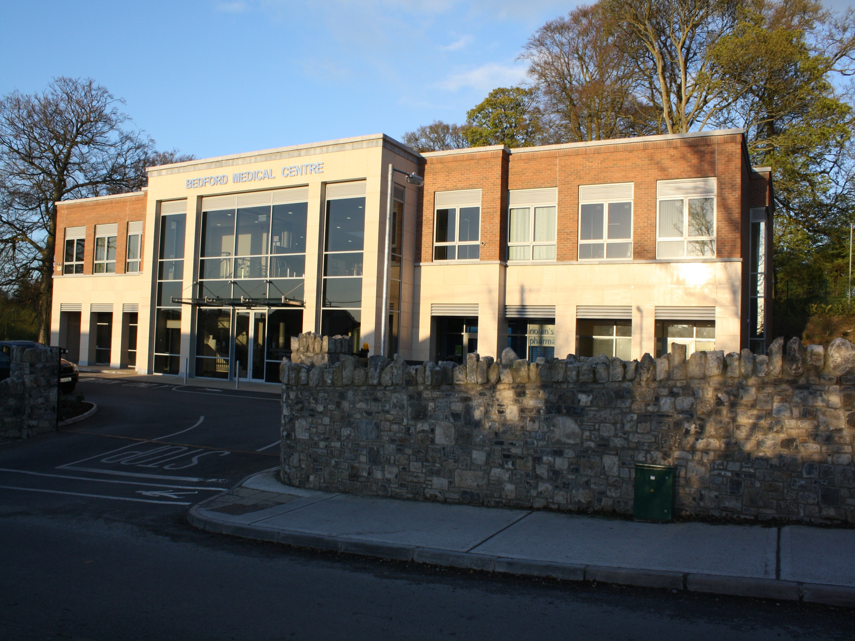
Bedford Medical Centre , Navan

Slide 3
The Exceptional Potential of Each General Practice
Rural vs Urban
Core vs Enhanced Practice
The Primary Care Surgical Association
Barriers to Enhanced Practice

Slide 4
The Exceptional Potential of Each General Practice
Rural vs Urban
Core vs Enhanced Practice
The Primary Care Surgical Association
Barriers to Enhanced Practice

Slide 5
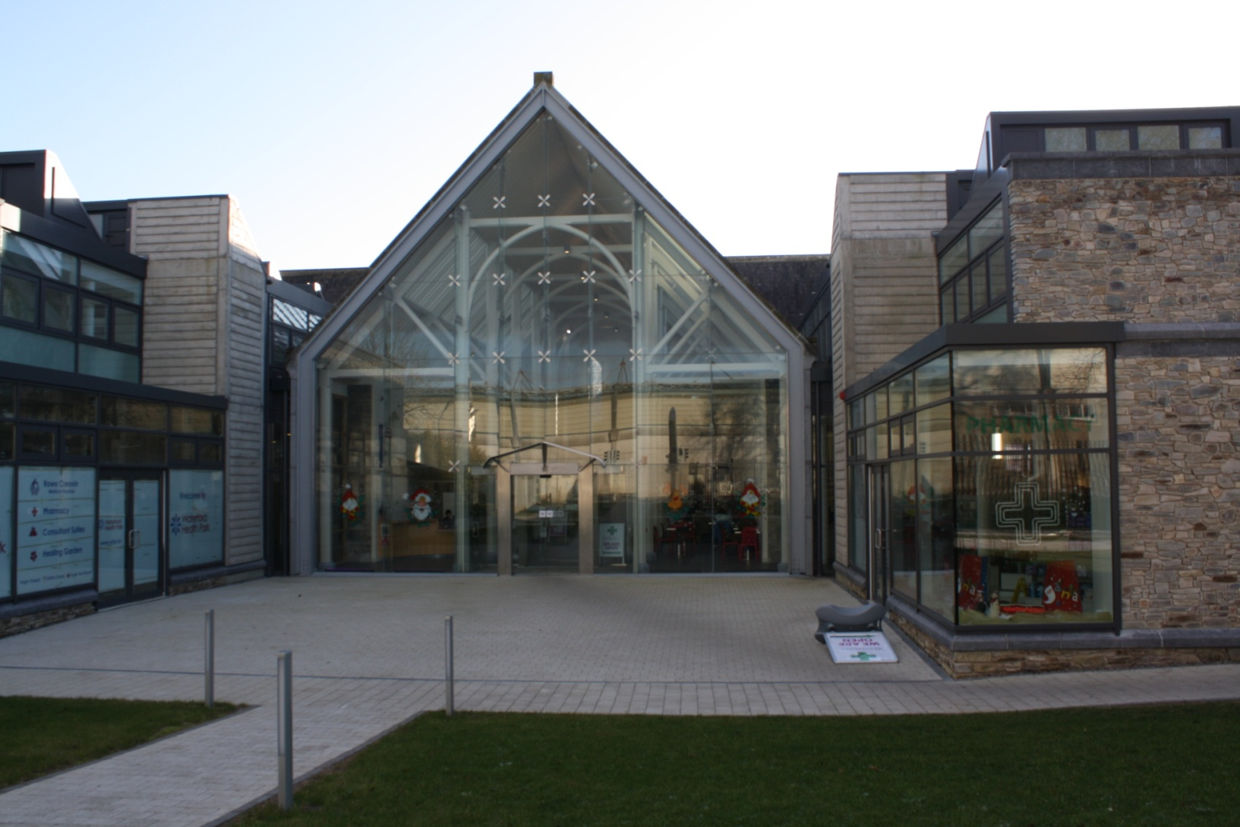
The Health Park, Waterford City

Slide 6
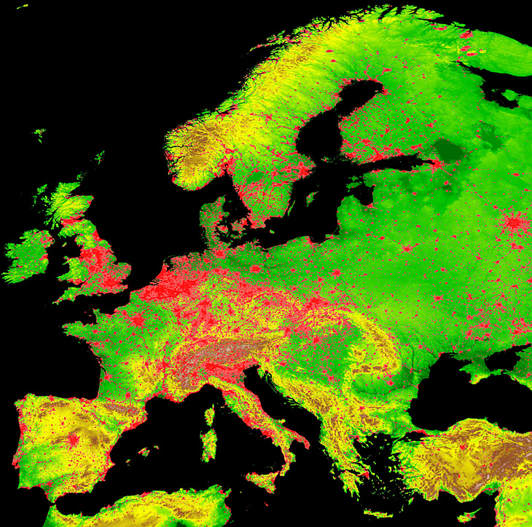
European level population density- Stable Night Lights
International Institute for Applied Systems Analysis (IIASA)

Slide 7
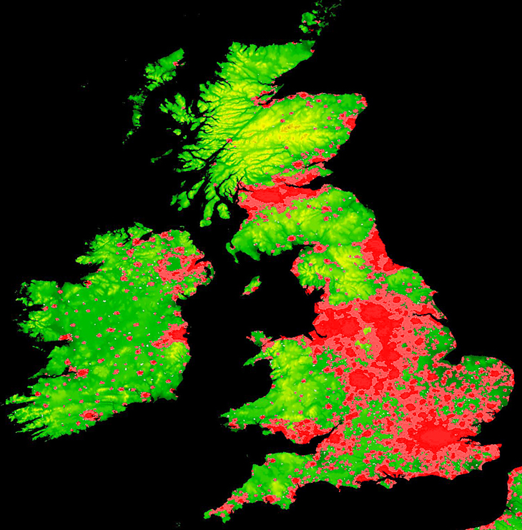

Slide 8
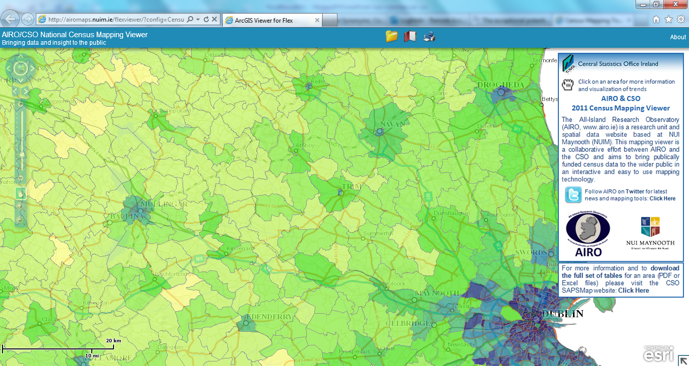
Census 2011 Population density AIRO NUI Maynooth
Navan Urban (3,168)(1789/km2)
Navan Rural (26,657)(453/km2)
Castletown Kilpatrick (1,017)(29.5/km2)

Slide 9
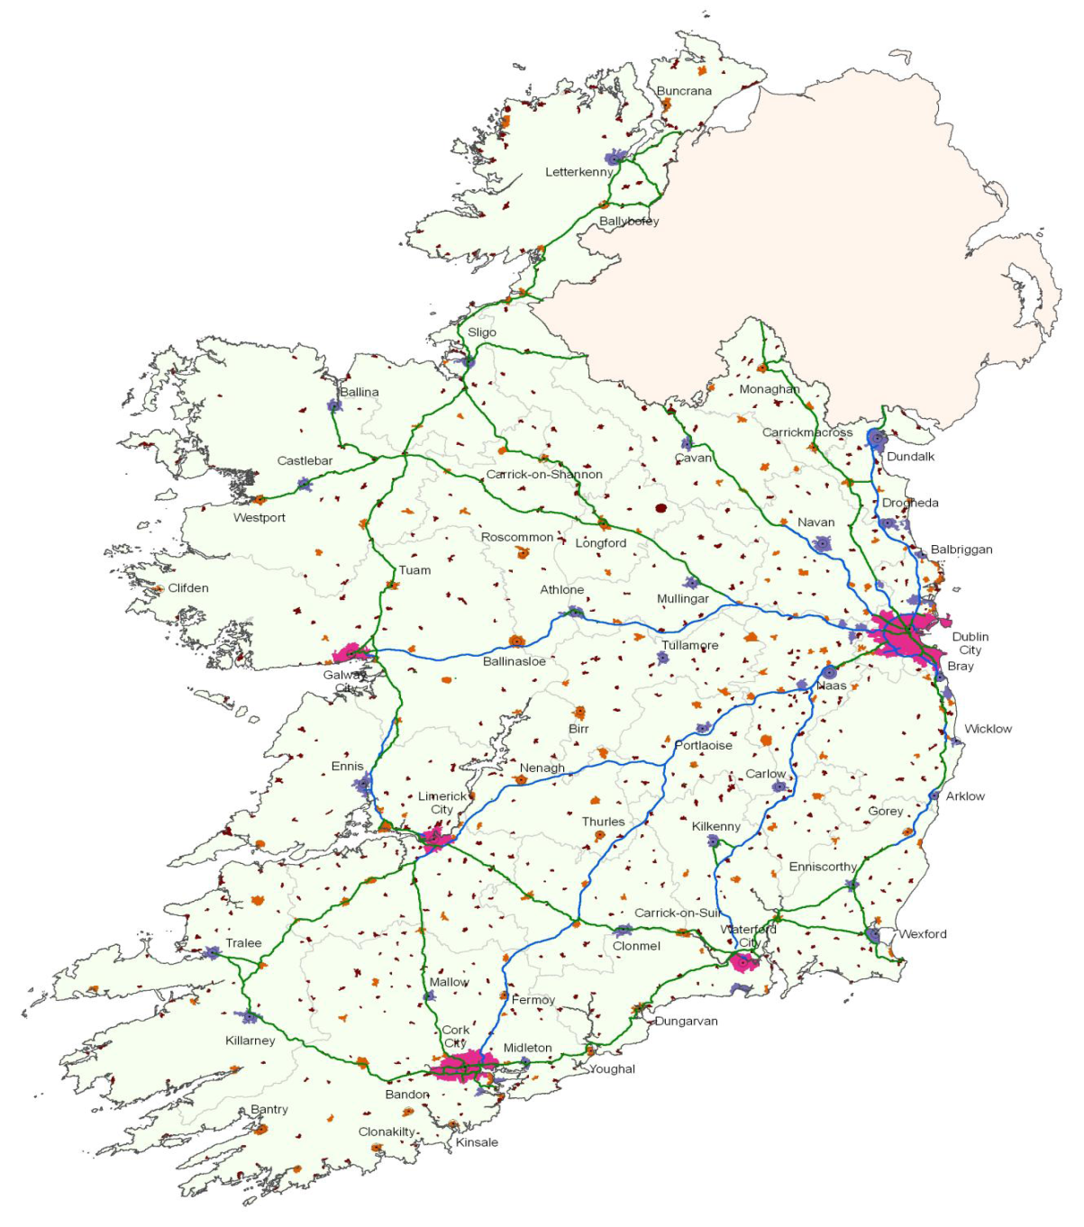
Census 2011
Cities and suburbs
Towns with population greater than 10000
Towns with population 1500-9999
Towns with population less than 1500

Slide 10
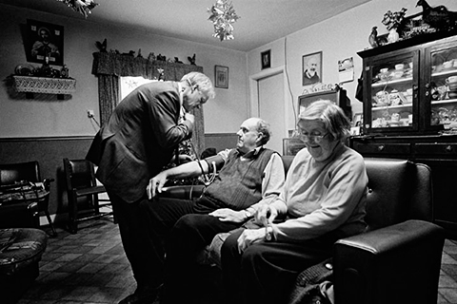

General Practice by Fionn McCann

Slide 11
The Exceptional Potential of Each Consultation. (Stott, Davis 1979)
Health promotion
Acute Illness
Chronic disease
Modifying Help Seeking Behaviour

Slide 12
The Exceptional Potential of Each General Practice
Rural vs Urban
Core vs Enhanced Practice
The Primary Care Surgical Association
Barriers to Enhanced Practice

Slide 13
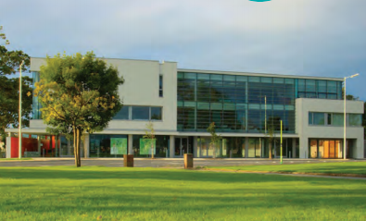
Grange Clinic, Donaghmede

Slide 14
The Exceptional Potential of Each Consultation. (Stott, Davis 1979)
THE CORE ELEMENTS
Health promotion
Acute Illness
Modifying Help Seeking Behaviour

Slide 15
The Exceptional Potential of the GP Practice
Occupational Health
Health Screening
Prison medical
Aeromedical
Events Medicine
Travel Medicine
Sexual Health
Addiction
Psychotherapy
Community Surgery
Emergency services
Enhanced Practice
Acute Illness

Slide 16
The Exceptional Potential of the GP Practice
NIDDM 430
COPD 252
Asthma 679
IHD
Hypertension 1452
Gout 260
HfeHC 52
Neuro/Psychiatry
......
Acute Illness
Chronic disease
Prevalence Bedford Med Centre, Navan

Slide 17
The Exceptional Potential of Each General Practice
Rural vs Urban
Core vs Enhanced Practice
The Primary Care Surgical Association
Barriers to Enhanced Practice

Slide 18
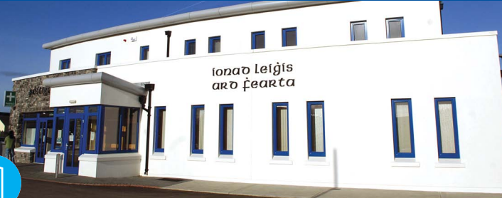
Ardfert Medical Centre

Slide 19
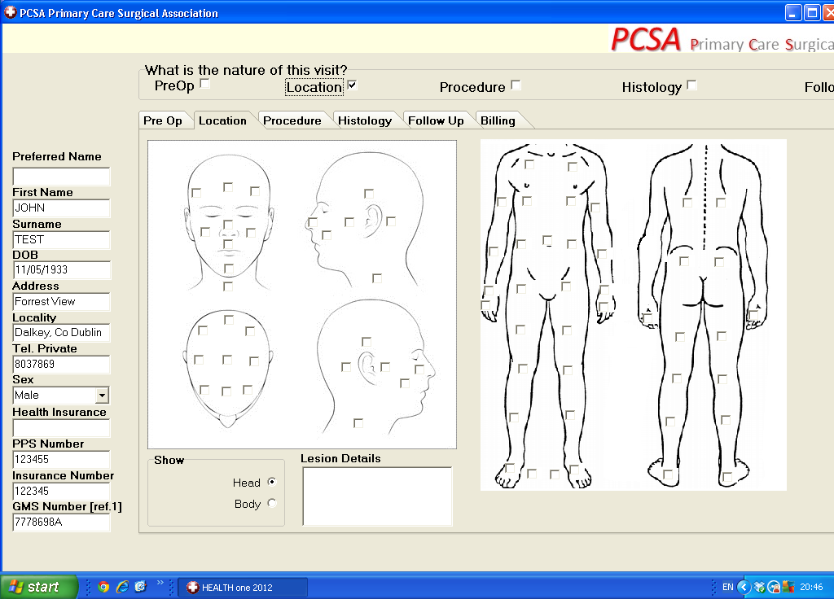

Slide 20
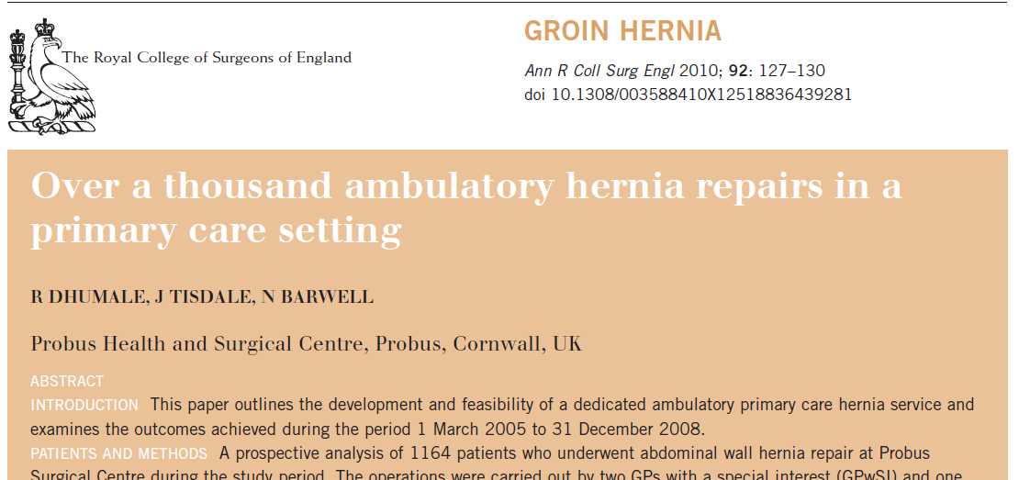

Slide 21
The Exceptional Potential of Each General Practice
Rural vs Urban
Core vs Enhanced Practice
The Primary Care Surgical Association
Barriers to Enhanced Practice

Slide 22
270 House calls
2,500 Repeat Prescriptions
2,700 Telephone Consultations
5,900 Consultations

Slide 23
270 House calls
2,500 Repeat Prescriptions
2,700 Telephone Consultations
5,900 Consultations
CDM

Slide 24
270 House calls
2,500 Repeat Prescriptions
2,700 Telephone Consultations
5,900 Consultations
CDM
AUDIT

Slide 25
HiQA
Medical Council
CDM
PCT Meetings
270 House calls
2,700 Telephone Consultations
5,900 Consultations
2,500 Repeat Prescriptions
AUDIT

Slide 26
GPs/100,000 population Eurostat 2012

Slide 27
Hospital Physicians/100,000 population Eurostat 2012

Slide 28
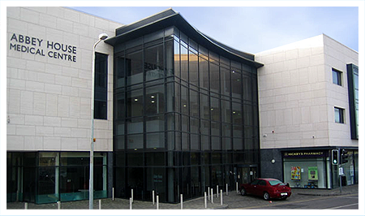
Abbey House Medical Centre, Navan

Slide 29

 | Hospital | GP
DocPay
Doc Pension
Accomodation
Equipment
Nursing
Admin

Slide 30
Productivity. Bedford Medical Practice 2005-2011
GMS list 1000s
Total Practice
Income € millions
6
6
6.5
7
7
7
7
No of GPs employed

Slide 31
Health gain as Investment Increases
Investment >>>>
Cost as Availability Increases
Availability >>>>

Slide 32

The rural GP

Slide 33
Outstanding in his own field

