Slide 1
What’s New in Diabetes
Maeve C. Durkan MBBS , FACP , Mmed.Ed
Consultant in Diabetes, Endocrinology & Metabolism

Slide 2
New Drugs ….
Incretins & Pancreatitis/ Pancreatic Cancer
Old Drugs …
Cardiovascular Safety trials …

Slide 4

Fat Topography
High TG
High FFA
TG
FFA
IS/
IR
Intramuscular
Fat
Subcutaneous
Fat
Intrahepatic
Fat
Intra-arterial
Fat
Intraabdominal
Fat
Artery
Rad 11/3/99
Bays H, Mandarino L, DeFronzo RA. J Clin Endocrinol Metab. 2004;89:463-78..
Notes:
4
Harold Bays, Lawrence Mandarino, and Ralph A. DeFronzo
Role of the Adipocyte, Free Fatty Acids, and Ectopic Fat in Pathogenesis of Type 2 Diabetes Mellitus: Peroxisomal Proliferator-Activated Receptor Agonists Provide a Rational Therapeutic Approach
J. Clin. Endocrinol. Metab., Feb 2004; 89: 463 - 478.

Slide 5
Stages of T2DM in relationship to B cell function
100
75
50
25
ß-Cell Function (%)
Impaired
glucose
tolerance
Postprandial hyperglycemia
DM2 phase I
DM2 phase II
DM2
phase III
-12 -10 -6 -2 0 2 6 10 14
Years from Diagnosis
50% of ß-cell function is already lost at diagnosis
Elevated PPG occurs before diagnosis
Tibaldi J, Rakel RE. Int J Clin Pract 2007; 61 (4): 633-644.

Slide 6
UKPDS: Glycemic Control With Monotherapy Worsens Over Time
Monotherapy With Insulin, Sulfonylurea (SU), or Metformin
9
8
Median HbA_{1c} (%)
7
Conventional (n=200)
Chlorpropamide (n=129)
Glibenclamide (n=149)
Metformin (n=181)
Insulin (n=199)
6
0
0
3
6
9
Years from randomization
Newly diagnosed overweight patients with type 2 diabetes. Data shown are medians for cohorts of patients followed for up to 10 years. Patient numbers shown are at 10 years.
Conventional therapy = diet alone; UKPDS = UK Prospective Diabetes Study
Adapted with permission from UKPDS Group. Lancet 1998;352:854–865.
Notes:
UKPDS: Glycemic Control With Monotherapy Worsens Over Time
A UKPDS study primarily compared the 411 overweight patients assigned conventional treatment and 342 overweight patients assigned intensive treatment with metformin, as designated in the protocol. A secondary analysis compared the 342 overweight patients allocated to metformin with 951 overweight patients allocated to intensive blood-glucose control with chlorpropamide (n=265), glibenclamide (n=277), or insulin (n=409).¹ Data for the cohort followed for up to 10 years are shown here.
In all the therapeutic groups, a gradual rise in HbA_{1C} levels occurred after an initial response that lowered the HbA_{1C} levels.¹
Reference:
1. UKPDS Group. Effect of intensive blood-glucose control with metformin on complications in overweight patients with type 2 diabetes (UKPDS 34). UK Prospective Diabetes Study (UKPDS) Group. Lancet 1998;352:854–865.

Slide 7
What did we get ?
What so we want ?
Past
Options Now
Limited choice
Weight gain
Hypoglycemia
⬆ risk approaching target
Β cell fatigue
Loss durability
Complications
More choice
Weight loss / neutrality
Less hypoglycemia
⬆ risk approaching targets
Β cell preservation !
Durability
Complications *

Slide 8
DURABILITY OF GLYCEMIC CONTROL WITH SULFONYLUREAS
1
Glyburide
Glyburide
Glimepiride
SU
0
Glyburide
GLY
Alvarsson (n=39)
SU
Alvarsson (n=48)
Gliclazide
RECORD (n=272)
Change in HbA1c (%)
Glyburide
Hanefeld (n=250)
Charbonnel (n=313)
-1
Gliclazide
UKPDS (n=1,573)
Chicago (n=230)
ADOPT (n=1,441)
PERISCOPE (n=181)
Tan (n=297)
-2
0
1
2
3
4
5
6
10
TIME (years)
Notes:
8

Slide 9
Mortality & HbA1c Targets
ACCORD ☒ 10250 , High risk, Diabetes Duration 8-10years
VADT ☒ 1791, High risk, Diabetes Duration 11.5 years
ADVANCE ☑ 11,140 Moderate risk*, Diabetes Duration 8 year
STENO ☑ 160, Low risk, Short Duration
UKPDS ☑ 3867, Low risk*, Newly diagnosed
DCCT ☑ 1441, Low risk, Diabetes Duration (1-15 years)

Slide 10
UKPDS / DCCT-EDIC
Early glycemic control = Cardiac mortality benefit
Macrovascular/cardiovascular benefit lost > 12 yr
‘Legacy Effect ’
‘Metabolic Memory’

Slide 11
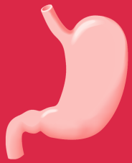
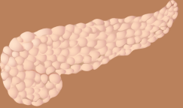
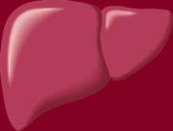


Anti-Diabetic Agents
Primary Sites of Action of Oral Antidiabetic Drugs (OADs)
α-glucosidase
inhibitors
Sulfonylureas/
meglitinides/
Incretins*
Biguanides
Thiazolidinediones
↓ Carbohydrate
breakdown/
absorption
↑ Insulin
secretion
↓ Glucose
output
↓ Insulin resistance
↓ Insulin
resistance
Kobayashi M. Diabetes Obes Metab 1999; 1 (Suppl. 1): S32–S40.
Nattrass M & Bailey CJ. Baillieres Best Pract Res Clin Endocrinol Metab 1999; 13: 309–329.

Slide 12
New Drugs in Pipeline
SGLT2 Inhibitors
Canagliflozin
Dapagliflozin
Empagliflozin
GLP1 Inhibitors
Lixizenatide ( Prandial GLP1)
Dulaglutide ( Once weekly)
GLP1 Inhibitors in DM1
Basal Insulins ….

Slide 13
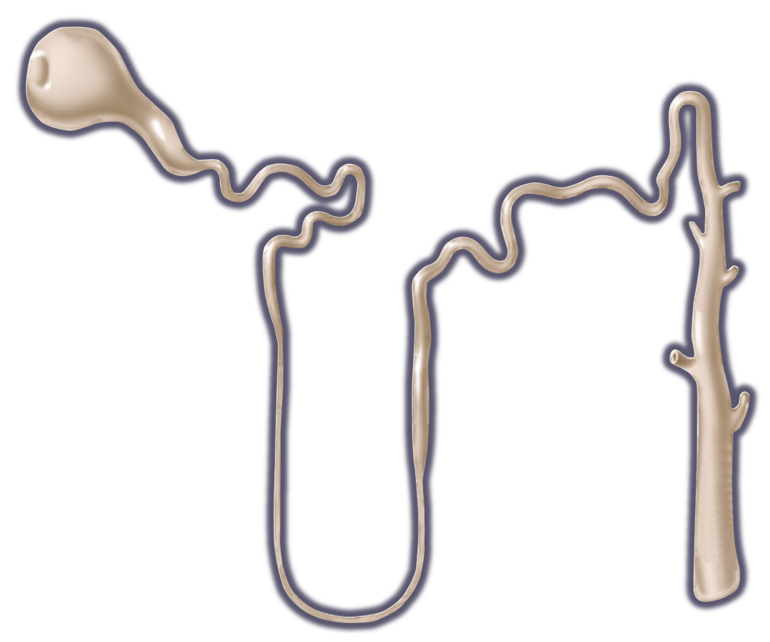
Glucose Reabsorption: Proximal Tubule
Glucose
Glomerulus filters
Proximal tubule reabsorbs
S1 segment of proximal tubule
~90% glucose reabsorbed
Facilitated by SGLT2
Collecting duct
Distal S3 segment of proximal tubule
~10% glucose reabsorbed
Facilitated by SGLT1
No glucose
in filtrate
SGLT: sodium glucose transporter
Silverman M, Turner RJ. In: Windhager EE, ed. Handbook of Physiology, Vol. II. New York, NY: Oxford University Press; 1992:2017-2038. Bakris GL, et al. Kidney Int. 2009;75:1272-1277.
Notes:
Several classes and types of mediators facilitate glucose transport in the renal tubules
Sodium-coupled glucose transporters (SLGTs) transport glucose across the renal tubule membrane, away from the urine
SGLT2 is located in the S1 segment of the proximal tubule and facilitates reabsorption of 90% of the glucose it filters
SGLT1 is in the distal S3 segment of the proximal tubule and facilitates reabsorption of the remaining 10%
Bakris GL, et al. Kidney Int. 2009;75:1272-1277.
Silverman M, Turner RJ. In: Windhager EE, ed. Handbook of Physiology, Vol. II. New York, NY: Oxford University Press; 1992:2017-2038.

Slide 14
Normal physiology of renal glucose homeostasis

Slide 15
SGLT2 inhibitors reduce renal glucose reabsorption
SGLT2 inhibitor

Slide 16
SGLT2 : Potential Role
DM2 at any level
Monotherapy in metformin intolerance
Combination therapy with OAD’s
Combination therapy with insulin
DM1 as adjunct therapy

Slide 17
SGLT2 …Salutory Effects
⬇ Body weight &
Body composition change with fat mass & central body fat
⬇ SBP
Clear difference in uncontrolled hypertension.
24 hour ambulatory BP sub study @ 3months (⬇ SBP & DBP)
⬇ Uric acid levels *
Lipids ..Clear ⬆ in LDL & HDL ( 6-12%)

Slide 18
SGLT2 Inhibitors
Pros
Cons
UTI & Genital tract infections
LDL ⬆ (unclear mechanism)
HDL ⬆ (unclear mechanism)
No CV signal yet
  Canvas
Limited to CKD ( eGFR>45)
Reversible shift in GFR
Easily added to anything, and/or insulin in DM1 & 2
Simple & dose response
Concomitant weight loss
SBP & DBP reduction
HbA1c reduction
No hypoglycemia

Slide 19
SGLT2 & Insulin
20-30% reduction in insulin doses
Still achieving HbA1c targets
⬇in hypoglycemic risk as one approaches targets

Slide 20
CV Safety & CV trials
Empagliflozin :EMPA-REG ( 7000 patients)
Dapagliflozin :DECLARE ( 17 000 patients)
Capagliflozin :CANVAS ( 4300 patients)*
Metanalysis ….
Dapagliflozin ( 14 trials)
Canagliflozin ( 9 trials)

Slide 21
UKPDS: Glycemic Control With Monotherapy Worsens Over Time
Monotherapy With Insulin, Sulfonylurea (SU), or Metformin
9
8
Median HbA_{1c} (%)
7
Conventional (n=200)
Chlorpropamide (n=129)
Glibenclamide (n=149)
Metformin (n=181)
Insulin (n=199)
6
0
0
3
6
9
Years from randomization
Newly diagnosed overweight patients with type 2 diabetes. Data shown are medians for cohorts of patients followed for up to 10 years. Patient numbers shown are at 10 years.
Conventional therapy = diet alone; UKPDS = UK Prospective Diabetes Study
Adapted with permission from UKPDS Group. Lancet 1998;352:854–865.
Notes:
UKPDS: Glycemic Control With Monotherapy Worsens Over Time
A UKPDS study primarily compared the 411 overweight patients assigned conventional treatment and 342 overweight patients assigned intensive treatment with metformin, as designated in the protocol. A secondary analysis compared the 342 overweight patients allocated to metformin with 951 overweight patients allocated to intensive blood-glucose control with chlorpropamide (n=265), glibenclamide (n=277), or insulin (n=409).¹ Data for the cohort followed for up to 10 years are shown here.
In all the therapeutic groups, a gradual rise in HbA_{1C} levels occurred after an initial response that lowered the HbA_{1C} levels.¹
Reference:
1. UKPDS Group. Effect of intensive blood-glucose control with metformin on complications in overweight patients with type 2 diabetes (UKPDS 34). UK Prospective Diabetes Study (UKPDS) Group. Lancet 1998;352:854–865.

Slide 22

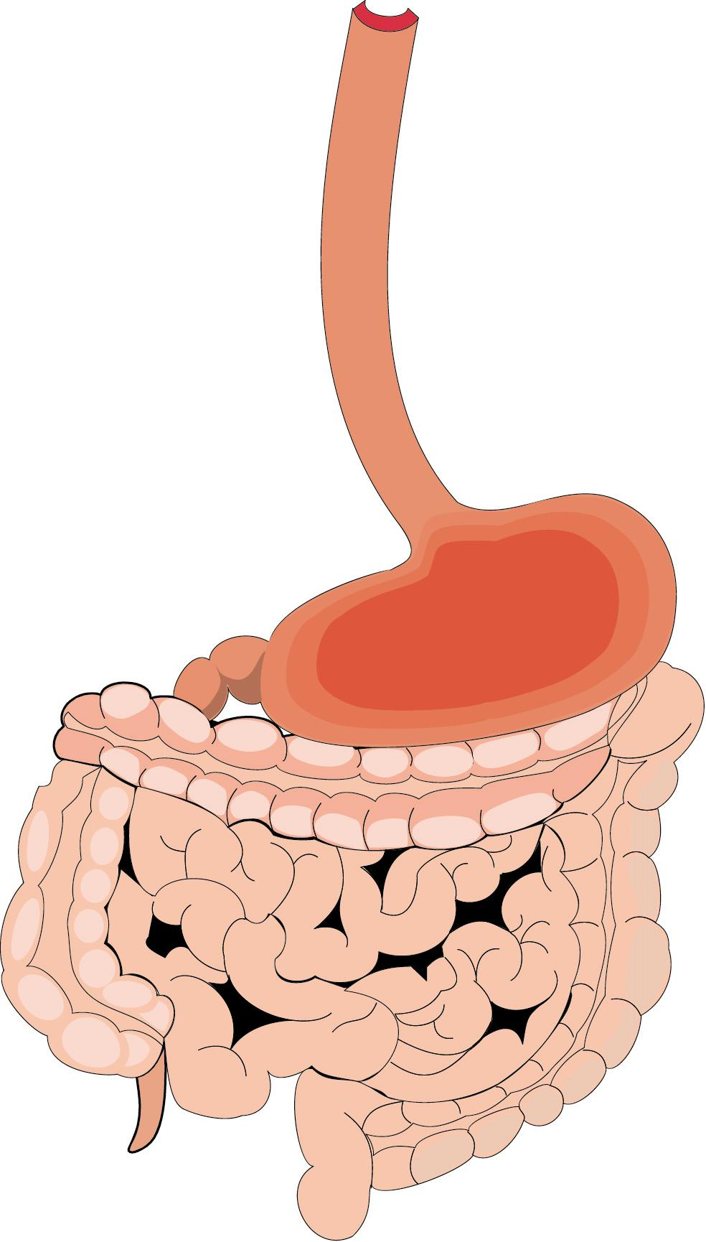
Incretins Modulate Insulin and Glucagon to Decrease Blood Glucose During Hyperglycemia
Meal
Increased insulin
(beta cells)
Muscle
Peripheral glucose uptake
Adipose
tissue
Glucose
Dependent
GIP
Gut
GLP-1
Pancreas
Physiologic Glucose Control
Glucose
Dependent
Decreased glucagon
(alpha cells)
Liver
Glucose
production
GLP-1=glucagon-like peptide-1; GIP=glucose-dependent insulinotropic polypeptide.
Brubaker PL et al. Endocrinology 2004;145:2653–2659; Zander M et al. Lancet 2002;359:824–930; Ahren B. Curr Diab Rep 2003;3:365–372; Buse JB et al. In Williams Textbook of Endocrinology. 10th ed. Philadelphia, Saunders, 2003:1427–1483; Drucker DJ. Diabetes Care 2003;26:2929–2940.
Notes:
Incretins Modulate Insulin and Glucagon to Decrease Blood Glucose Levels During Hyperglycemia
This schematic summarizes the pathways related to the observed effects of glucagon-like peptide-1(GLP-1) and glucose-dependent insulinotropic polypeptide (GIP) on insulin and GLP-1 on glucagon.
Following a meal, the release of incretins is stimulated: GLP-1 from L cells located primarily in the distal gut (ileum and colon) and GIP from K cells in the proximal gut (duodenum).¹
Together, these incretins enhance the insulin response of the pancreatic beta cells to an oral glycemic challenge.¹ GLP-1 helps suppress glucagon secretion from pancreatic alpha cells when glucose levels are elevated.²⁻⁵
The subsequent insulin-induced increase in glucose uptake by muscles and other tissues and the reduced glucose output (the result of increased insulin and decreased glucagon) from the liver result in better physiologic control of glucose levels.²⁻⁵
References
Drucker DJ. Enhancing incretin action for the treatment of type 2 diabetes. Diabetes Care
2003;26:2929–2940
Brubaker PL, Drucker DJ. Minireview: Glucagon-like peptides regulate cell proliferation
and apoptosis in the pancreas, gut, and central nervous system. Endocrinology 2004;145:
2653–2659.
Zander M, Madsbad S, Madsen JL et al. Effect of 6-week course of glucagon-like peptide 1 on glycaemic control, insulin sensitivity, and β-cell function in type 2 diabetes: A parallel-group study. Lancet 2002;359:824–830.
Ahrén B. Gut peptides and type 2 diabetes mellitus treatment. Curr Diab Rep 2003;3:365–372.
Buse JB, Polonsky KS, Burant CF. Type 2 diabetes mellitus. In: Larsen PR, Kronenberg HM, Melmed S et al, eds. Williams Textbook of Endocrinology. 10th ed. Philadelphia: Saunders, 2003:1427–1483.

Slide 23
GLP-1 restores insulin and glucagon responses in a glucose-dependent manner in type 2 diabetes
GLP-1†
Saline
Glucose (mmol/L)
C-peptide (nmol/L)
Glucagon (pmol/L)
17.5
15.0
12.5
10.0
7.5
5.0
2.5
0.0
3.0
2.5
2.0
1.5
1.0
0.5
0.0
30
25
20
15
10
5
0
Infusion
Infusion
Infusion
*
*
*
*
*
*
*
*
*
*
*
*
*
*
*
*
–30 0 30 60 90 120 150 180 210 240
–30 0 30 60 90 120 150 180 210 240
–30 0 30 60 90 120 150 180 210 240
Time (min)
Time (min)
Time (min)
†GLP-1(7–36 amide) infused at 1.2 pmol/kg/min for 240 min. *p<0.05
Adapted from Nauck MA et al. Diabetologia 1993;36:741–4. Type 2 diabetes patients, n=10
Notes:
GLP-1 Restores Insulin and Glucagon Responses in a Glucose-Sensitive Manner in Patients with T2DM
The glucose-dependent effects of glucagon-like peptide-1 (GLP-1) on insulin and glucagon responses were demonstrated in a study of type 2 diabetes mellitus (T2DM) patients with poor metabolic control.¹
Ten patients with T2DM in whom diet and medications had yielded unsatisfactory glycemic control (HbA1c 11.6 ± 1.7%) underwent intravenous infusion of saline (placebo) or GLP-1(7–36 amide) (infused at 1.2 pmol/kg/min for 240 minutes) in the fasting state.
GLP-1 infusion led to a significant drop in plasma glucose (left-hand graph) compared with the effect of saline solution.
Insulin levels in response to the GLP-1 infusion, measured as C-peptide (middle graph), rose significantly during the initial phase when glucose was in the higher range. As glucose level asymptotically approached normal range, the insulin level concomitantly dropped despite continuous GLP-1 infusion.
Glucagon (right-hand graph) levels were significantly reduced in response to higher glucose levels; glucagon levels then increased as the glucose level asymptotically approached normal range despite continuous GLP-1 infusion.
These findings suggest that GLP-1 stimulates sensitivity of pancreatic α- and β-cells to secrete glucagon and insulin, respectively, in a glucose-dependent manner.
This slide thus illustrates why GLP-1 is an effective means of addressing post-prandial glucose excursions
Reference
Nauck MA, et al. Normalization of fasting hyperglycaemia by exogenous glucagon-like peptide 1 (7-36 amide) in type 2 (non-insulin-dependent) diabetic patients. Diabetologia. 1993; 36: 741–744.

Slide 24
Choice of GLP-1 receptor agonist:
short acting versus long acting
The pharmacological profile and half-life of a GLP-1 receptor agonist influences its effects on postprandial and basal (fasting) glycaemia
SHORT ACTING
GLP-1 receptor agonists
eg. Lixisenatide OD, Exenatide BD
LONG ACTING
GLP-1 receptor agonists
eg. Liraglutide OD, Exenatide QW
or
Effect on
FPG
Effect on
PPG
Effect on
FPG
Effect on
PPG
FPG = fasting plasma glucose PPG = postprandial glucose
Fineman MS et al. Diabetes Obes Metab 2012;14:675-88
Notes:
Speaker Notes
It is becoming increasingly apparent that the GLP-1 receptor agonist class can be subdivided into 2 types which result in different effects on fasting and postprandial glucose levels:
As a consequence of their pharmacological profiles, prandial GLP-1 receptor agonists such as exenatide and lixisenatide, have a greater effect on lowering postprandial glucose levels, than they do fasting glucose levels.
Similarly as a consequence of their pharmacological profile and more protracted half lives Non-prandial GLP-1 receptor agonists such as liraglutide and once weekly exenatide have relatively greater effects on fasting plasma glucose levels.
Reference
Fineman MS, et al. GLP-1 based therapies: differential effects on fasting and postprandial glucose. Diabetes Obes Metab. 2012;14(8):675-688.
Annotation
Fineman. Diabetes Obes Metab.January.2012/p1/lines A6-A8; p9/c2/table 3

Slide 25

Complementary actions on FPG and PPG may provide additional HbA_{1c} control
+
Short Acting GLP-1 receptor agonist^{1**}
Basal Insulin*
FPG
PPG
FPG
PPG
7.0% 53 mmol/mol
HbA_{1c}
* Insulin glargine ** Exenatide 10 mcg BD
Primary outcome: HbA_{1c} decreased by 1.74% with exenatide and 1.04% with placebo (between-group difference -0.69%, p<0.001)²
FPG = fasting plasma glucose; PPG = postprandial glucose
¹Fineman MS et al. Diabetes Obes Metab 2012;14:675-88
²Buse JB et al. Ann Intern Med 2011;154:103-12
Notes:
Speaker Notes
In order to deliver optimal blood glucose control targets, both fasting and post prandial blood glucose levels need to be addressed³. Basal insulin is an effective means of targeting fasting plasma glucose ², while the addition of a prandial GLP-1 receptor agonist represents an ideal complementary therapy in combination with optimally titrated basal insulin^{1,2}, in order to provide additional improvements in Hba1c. Indeed, Targeting FPG with basal insulin in patients insufficiently controlled (HbA1c <7%) on oral agents has been shown to markedly increase the relative contribution of postprandial glucose to overall glycaemia from 20–24% to 59–69%⁴. Thus, in terms of achieving HbA1c targets, a focus on postprandial glucose may become increasingly relevant at lower (but still suboptimal) HbA1c levels⁵.
Furthermore, postprandial glucose may also be an important determinant of diabetes-related complications both independently and through a contribution to overall glycaemia⁶.
References
Fineman MS et al. GLP-1 based therapies: differential effects on fasting and postprandial glucose. Diabetes ObesMetab. 2012;14(8):675-688
Buse JB et al. Use of twice-daily exenatide in basal insulin–treated patients with type 2 diabetes. Ann Intern Med. 2011;154(2):103-112
Standards of medical care in diabetes—2012. Diabetes Care. 2012;35(Suppl 1):S11-S63.
Riddle M et al. Contributions of basal and postprandial hyperglycemia over a wide range of A1C levels before and after treatment intensification in type 2 diabetes. Diabetes Care. 2011;34: 2508-2514
Monnier L et al. Contributions of fasting and postprandial plasma glucose increments to the overall diurnal hyperglycemia of type 2 diabetic patients: variations with increasing levels of HbA_{1c}. Diabetes Care 2003; 26: 881–885
Ceriello A et al. International Diabetes Federation guideline for management of post-meal glucose: a review of recommendations. Diabet. Med. 2008; 25: 1151–1156.
Annotations
Buse.Ann Intern Med.December.2011/p103/c2/lines 1-6
Buse.Ann Intern Med.December.2011/p108/c1/lines 19-21
Buse.Ann Intern Med.December.2011/p108/c2/lines 1-10
Buse.Ann Intern Med.December.2011/p110/c1/lines 3-21

Slide 26
New GLP1
Lixizenatide ( Lyxiuma)
Prandial GLP1
Combination with basal insulin in DM2
  Reduced insulin doses
  Reduced FPG & PPG
  Greater attainment A1c targets
  Less hypoglycemia
Similar outcome c/w prandial insulin

Slide 27
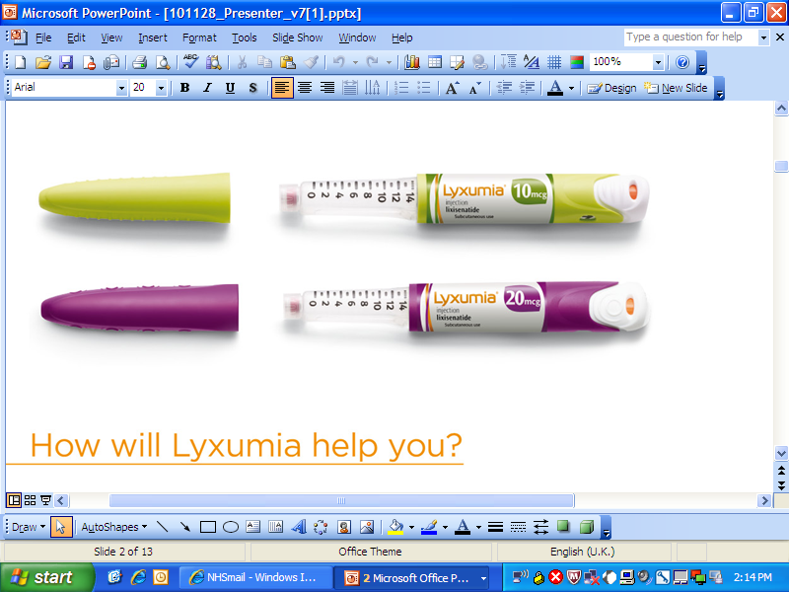
Lixisenatide: prefilled fixed-dose pen
10 mcg
20 mcg
Notes:
There are two different pens for the different doses
Pens are coloured coded for the different doses
Green for the 10 mcgs
Purple for the 20 mcgs dose
In addition, the pens have ridges on so that people who are sight impaired can distinguish between the two for safety

Slide 28
New GLP1
(once weekly)..Delaglutide
Colourless
HbA1c reductions simliar to Exentauide LAR
No reconstitution

Slide 29
GLP1 analogues in DM1
Liraglutide : Pilot study
10 weeks only ; Pilot study
No adverse outcomes
20-30% reduction Insulin doses ( Basal)
Greater attainment HbA1c
Less hypoglycemia
Less weight gain
  EASD 2013

Slide 30
GLP1 analogs & DM1
Krieger et al., Diab Care
  29 patients, Liraglutide , 8 weeks, CGM
  ⬇insulin dose, ⬇ weight, ⬇ hypos, ⬇ time in hypo
Varanasi et al, Eur J Endo 2011
  14 patients , 8 for 24weeks Liraglutide ,
  ⬇ insulin dose, ⬇ weight, ⬇ time in hyperglycemia
Harrison et al , J Invest Med 2013
  Liraglutide in11 patients on insulin pump , ⬇ insulin dose
Kuhadiye et al, Endo practice
  DM1 , Liraglutide & CSII

Slide 31
DPP IV Inhibitors & DM1
Vildagliptin
  Farngren et al, JCEM 2012 ( 28 patients, DM1 2-20years, 8weeks)
Sitagliptin
  Ellis et al , Diabe Med 2011 ( DM1 15-20 years, 8 weeks )

Slide 32
Pancreatitis
Cigarette smoking …Dose dependent effect
500 drugs reported ..60 confirmed on rechallenge
Metabolic causes: Obesity, ETOH, High Tg, Obesity
DM2 alone confers 1.5 -3 fold risk

Slide 33
DPPIV (Gliptins) & Pancreatitis
Acute Pancreatitis | Drug Arm | Placebo Arm
Alogliptin (EXAMINE) 5380 NEJM , Oct 3, 2013 | 12 | 8 | Numeracy ⬆ ns
Saxagliptin ( Savor TIMI 53) 16,459 NEJM Oct 3, 2013 | 17 | 9 | Numeracy ⬆ ns
Monitoring Lipase/ Amylase ? | No role currently
Patients in whom to avoid prescription ? | Acute Pancreatitis Chronic pancreatitis Alcohol excess

Slide 34
GLP1 Drugs
& Pancreatic Cancer
McGovern , 2011
Butler et al, Diab Med 2013

Slide 35
DPPIV (Gliptins) & Pancreatic Cancer
Acute Pancreatitis | Drug Arm | Placebo Arm
Liraglutide | Dose dependent increase beta cell mass at 52 weeks ( female only), but no dose increase after 87 week
Alogliptin ( EXAMINE) 5380 | Same pancreatic cancer Same (51 any cancer) | 55 any cancer
Saxagliptin ( Savor TIMI 53) 16000 | 5 pancreatic cancer c/w 12 placebo Same (327 any cancer) | 362 any cancer

Slide 36
Cardiovascular Safety & Benefit
Glucophage
Sulphonylureas
Pioglitazone/ Rosiglitazone
Insulin
DPPIV Inhibitors
GLP1 agonists

Slide 37
What about the Old Days ?Metformin
UKPDS ….5102 patients
Newly diagnosed
3876 Randomized to diet, insulin, sulphonylurea
753 ( Body weight >20%)…diet or metformin
Target FBS <15, interim change to < 6
1st trial 1997….vs. diet , RR reduction cv event 36%
But : Underpowered & number 342
HR 0.84 , p = 0.052
30 years 2012 …HR 0.85, p 0.014

Slide 38
What about the Old Days ? Sulphonylurea
Phung et al , Diab Med 2012
SU ..RR 1.27 ( Cardiac death)
SU...RR 1.10 (Cardiac event)
SU compared with Metformin ….RR 1.26 ( Cardiac Death)
….RR 1.10 ( Cardiac event)

Slide 39
DPPIV (Gliptins) & Heart Failure*
Acute Pancreatitis | Drug Arm | Placebo Arm | P value
Alogliptin (EXAMINE) High Risk / ACS | 12 (0.4%) 11.3% (1⁰ event) | 8 (0.3%) 11.8% (1⁰ event) | Top quintile ProBNP ns
Saxagliptin ( Savor TIMI 53) 16000 | 3.5% (613/7.3% 1⁰event) | 2.8% 609/7.2% 1⁰ event) | Top quintile ProBNP ns
Vildagliptin | No excess CHF, but LV volume increase
TECOS critical

Slide 40
DPPIV (Gliptins) & Microalbuminuria
Acute Pancreatitis | Drug Arm | Placebo Arm
Alogliptin (EXAMINE) | Reduced progression
Saxagliptin ( Savor TIMI 53) 16000 | Significant reduction in progression* and more improved

Slide 41
DPPIV (Gliptins) & Hypoglycemia
Acute Pancreatitis | Drug Arm
Alogliptin (EXAMINE) 5389 | Linked to Su therapy c/w placebo
Saxagliptin ( Savor TIMI 53) 16 , 492 | Linked to SU therapy c/w placebo | Especially with A1c <7%

