Slide 1
Rural, Island and Dispensing Doctors of Ireland
David Molony
06/10/2012
Notes:
This template can be used as a starter file for presenting training materials in a group setting.
Sections
Right-click on a slide to add sections. Sections can help to organize your slides or facilitate collaboration between multiple authors.
Notes
Use the Notes section for delivery notes or to provide additional details for the audience. View these notes in Presentation View during your presentation.
Keep in mind the font size (important for accessibility, visibility, videotaping, and online production)
Coordinated colors
Pay particular attention to the graphs, charts, and text boxes.
Consider that attendees will print in black and white or grayscale. Run a test print to make sure your colors work when printed in pure black and white and grayscale.
Graphics, tables, and graphs
Keep it simple: If possible, use consistent, non-distracting styles and colors.
Label all graphs and tables.

Slide 2
Introduce concept of Mallow’s 4th Practice.

Slide 4
Mallow Primary Healthcare Centre
Co-operative venture between GPs.
2004.
3 Group Practices
8 sites.
2006 agreed HSE, 2008 signed HSE.
Building started March 2009.
GPs in May 2010.
HSE in Aug. 2010.

Slide 5
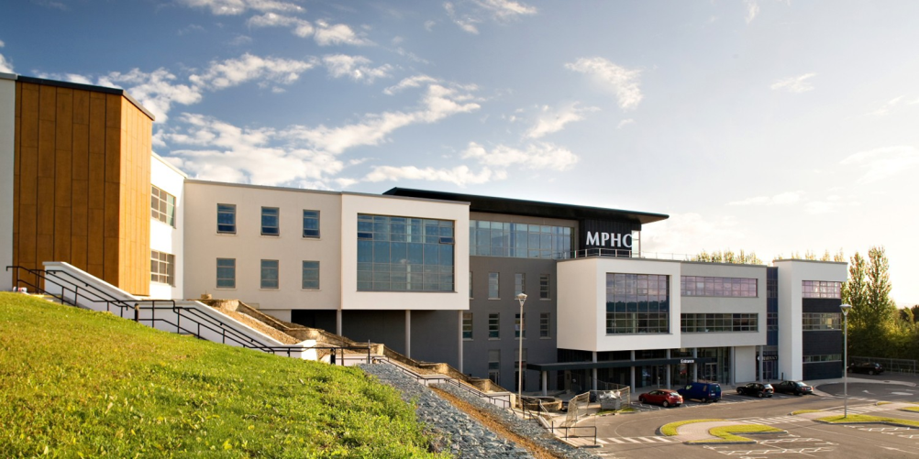

Slide 6
MPHC---jobs
GP related jobs 53.
HSE related jobs 138.
Others 31
New jobs 22.
New Services in the community 23
TOTAL 244

Slide 7
Best Advice
Get BEST Professional Services.
Accommodate others views.
Open all ideas.
Exceptional record keeping.
Rapid decision making.

Slide 8
Patient Services
What is General Practice/Primary Care ?
IMO/ICGP view.
DOH/HSE view.

Slide 9
What is not General Practice?
Not GP but belongs in PCC.
Cardiac -24 hr BP, 24 hr ECG, Stress Testing, Echo,
Respiratory – Spirometry, Asthma, COPD, Sports, Occupational Assessments.
Audiology – screening workers, hearing aids etc.
Occupational/Legal work.
Minor Ops, venesection,
Warfarin, Phlebotomy, DMARDS,
Foreign travel vaccinations.
Visiting Consultants/ Auxillary specialists.
Diagnostics.

Slide 10
The 4TH Practice.
(Separate entity but linked to practices)
Own premises, own staff, own database.
Intrinsically linked to the practices.
Services for MPHC and outside practices.
New enhanced care in the community.
GP extra skills recognised/used.
Other specialist providers to community.

Slide 11
GPs in 4TH Practice
Travel Medicine, Sports Medicine, Occupational Medicine,
Enhanced Cardiac, Respiratory, Diabetic Clinic and Skin clinic with specialist nurses.
Research and Education- UCC/UL/HSE/DOH.

Slide 12
Other Doctors in 4TH Practice
Neurology – Migraine clinic and general neurology
Sports Medicine and Orthopedics, Cardiology, Respiratory.
Community Ophthalmology– assist Diabetic Eye Screening,

Slide 13
Nurse roles in 4TH Practice
Specialist nurse clinics in Diabetes, Dermatology.
Warfarin Clinic, Phelbotomy, Venesection,Qutenza,ECG,24hr BP/Holter,
Research Projects

Slide 14
Other Professionals in 4TH Practice
Physio, Osteopath, Podiatry, S&L,
Dietician – illness mgt., healthy options, group courses.
Psychologist – adult/child, Behaviour/Cognitive asses.

Slide 15
Management roles in 4TH Practice
Organise Clinics , Appointments, Letters & Finances
Organise Students Regs, Clinical meetings, CME CPD Points Research Projects
Own Patient Database with seamless Integration to GP Practices

Slide 16
Advantages of the 4TH Practice
Clinical—Warfarin, specialised clinics, diagnostics, new services,
DMARD Clinic ?
Service Resource for patient , GP owned task specific, no corporates.
Integration ,efficiency , economy of scale, management.

Slide 17
4th PRACTICE INGREDIENTS
GP Co-operation and respect-shareholding.
Separate high quality rooms & structure.
Own IT linked to practices.
Own staff.
Efficient services/standard.
Infrastructure, ?Dispense medicines,
Back up hospital services.
Run as efficient business.
Notes:
Give a brief overview of the presentation. Describe the major focus of the presentation and why it is important.
Introduce each of the major topics.
To provide a road map for the audience, you can repeat this Overview slide throughout the presentation, highlighting the particular topic you will discuss next.

Slide 18
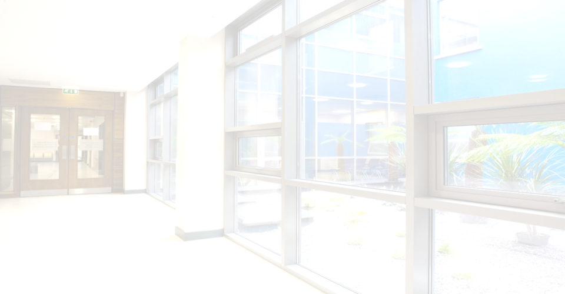
Building alone will not do it.
PC is services to patients in their community.

Slide 19
Primary Care ---- the FUTURE
More work for the patient.
More team-work in practices.
More team-work in the community.
Better use of GP skills with diagnostics.
GPs coming together to provide more services for their patients.
4TH Practices do not need expensive build but need GP co-operation.
Opportunity for GPs to invest in their futures.
Proud to be a ‘VESTED INTEREST’ who knows patient needs and deliver appropriately.
Notes:
Summarize presentation content by restating the important points from the lessons.
What do you want the audience to remember when they leave your presentation?
Save your presentation to a video for easy distribution (To create a video, click the File tab, and then click Share. Under File Types, click Create a Video.)

